Slide 1
AS and A Level Computer Science, Pseudocode Guide
SLR1 THE PROCESSOR
SLR15 BOOLEAN ALGEBRA
SLR8 BASIC PROGRAMMING
SLR16 COMPUTER LEGISLATION
SLR2 TYPES OF PROCESSOR
SLR22 THINKING CONCURRENTLY
SLR9 CEH
SLR3 INPUT, OUTPUT AND STORAGE
SLR23 PROGRAMMING TECHNIQUES
SLR10 DATABASES
SLR17 MORAL, SOCIAL, ETHICAL ISSUES
SLR4 OS AND SYSTEM SOFTWARE
SLR24 COMPUTATIONAL METHODS
SLR11
NETWORKS
SLR18 THINKING ABSTRACTLY
SLR25 ALGORITHMS
SLR5 APPLICATION GENERATION
SLR12 WEB TECH
SLR19 THINKING
AHEAD
SLR6 SOFTWARE GENERATION
SLR20 THINKING PROCEDURALLY
SLR26 ALGORITHMS 2
SLR13 DATA TYPES
SLR7 PROGRAMMING LANGUAGES
SLR14 DATA STRUCTURES
SLR21 THINKING LOGICALLY

Slide 2
SLR1
FDE CYCLE
PIPELINING
ARCHITECTURE
BUSES
OPERATION CODE
CACHE

Slide 3
FETCH
DECODE
EXECUTE

Slide 4
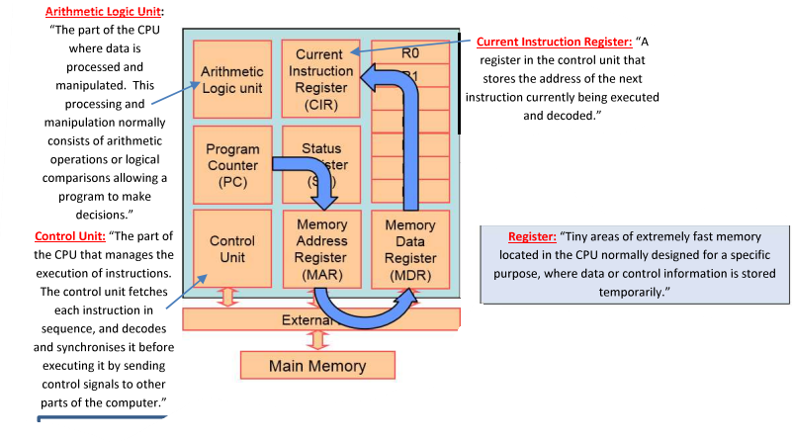
FETCH
The PC holds the address of the next instruction to be carried out
This address is copied into the MAR
The contents of the address in the MAR are copied into the MDR
The contents of the MDR are copied into the CIR
The contents of the PC are incremented

Slide 5
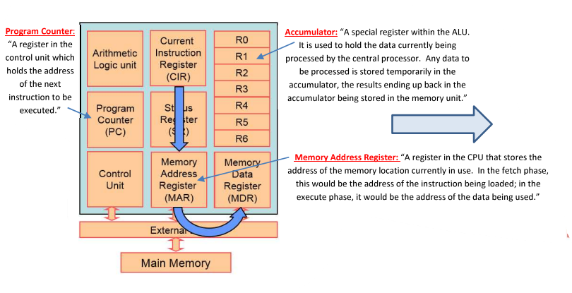
DECODE
The contents of the CIR are then divided into the binary code standing for the operation to be carried out, and probably the address of the data that will be used by the program.
The control unit then interprets the operation code so that the processors knows what to do next

Slide 6
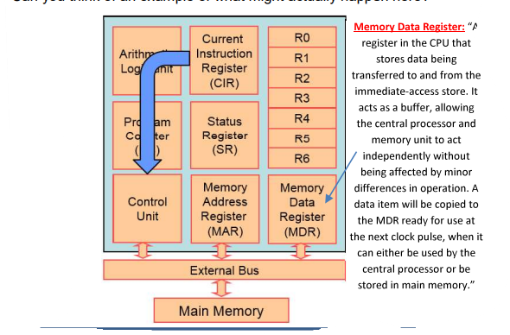
EXECUTE
The address part of the instruction is copied from the CIR to the MAR
The data found in the address in the MAR is copied to the MDR
The data is used depending on the instruction.

Slide 7
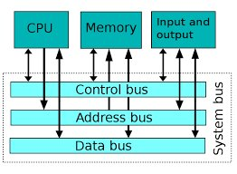
Data Bus:
Bi- directional and is used to transport data
and instructions between components.
The amount of data that can be carried depends on
the word size such as 8 bytes.
BUSES
Address Bus:
A unidirectional bus which is used to transmit memory addresses from the CPU to RAM specifying where data is to be sent to retrieved from.
The width of the address bus is proportional to the number of addressable memory locations.
Control bus:
Bi-directional bus that ensures access and use of data and address buses without conflict through control lines.
E.g. of control lines:
Bus request, a device is requesting the use of the data bus
Bus grant, CPU has granted access to the data bus
Memory Write, Data on the data bus to be written in the addressed location
Memory Read, Causes data from the addressed location to be placed on the data bus
Interrupt request: Indicates that a device is requesting access to the CPU.
Clock, synchronizes operation.

Slide 8
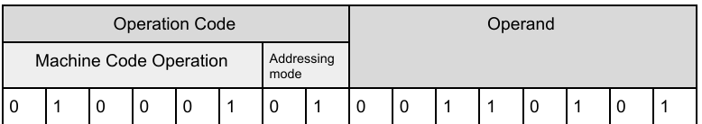
OPERATION CODE
Example of an instruction with a 16-bit word format that would be transferred by the data/ address bus.
The instruction is split into the Operand and Opcode in the CIR.
The Opcode contains the type of instruction, and the Operand contains the data or the address of the data upon which the operation is to be performed.

Slide 9
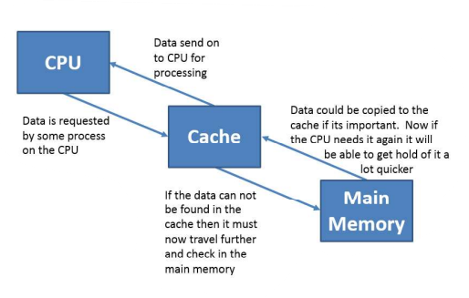
CACHE
Three Cache Types:
Level 1: Loaded directly on the CPU itself, very low capacity, very expensive, typically runs at the same speed as CPU
Level 2: Often part of the CPU module, still expensive, larger capacity but less than 1MB
Level 3: Often located further away on the motherboard, less expensive and larger capacity – multiple MBs. Typically shared between cores.
A part of the main memory storage between the CPU and the rest of the memory.
It has extremely fast access, so sections of a program and its associated data are copied there to take advantage of its short fetch cycle.
The larger the cache size the faster the CPU can perform. The other factors of CPU performance are:
Clock Speed: Time taken for one clock cycle to complete
Number of cores: Number of independent processors that can run FDE cycles although not all programs are able to utilize multiple cores efficiently.

Slide 10
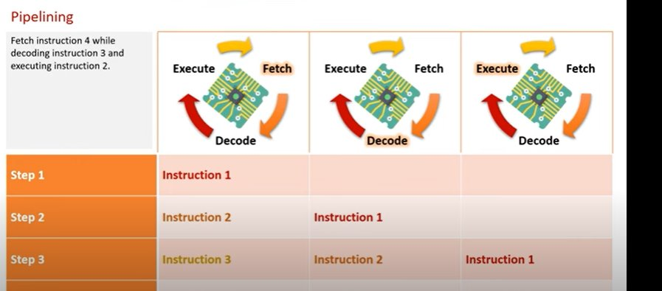
PIPELINING
Process of carrying out multiple instructions simultaneously by having each instruction at a different stage of the FDE cycle.
It is used to reduce the time the CPU is idle, reduce latency and so all parts of the processors can be used at any instance in time.
In the case of a "branch" (selection) the pipeline is flushed – the CPU cannot ensure that it will correctly process its instruction pipeline in the next clock cycle, so it restarts the pipelining process.

Slide 11
Contemporary processing:
A combination of Harvard and Von Neumann. Von Neumann is used when working with data and instructions in main memory, Harvard architecture to divide the cache into instruction and data cache.
ARCHITECTURE
Von Neumann architecture:
Includes the basic components of the computer and processor in which a shared memory and data bus is used for both data and instructions.
Von Neumann architecture is built on the stored program concept.
VON NEUMANN ARCHITECTURE: | HARVARD ARCHITECTURE
Used in conventional processors in PCs, s and embedded systems with only control functions. | Used In digital signal processing and in embedded systems, mobile communication systems, audio, speech and image processing systems.
Data and programs share the same memory | Instructions and data are held in separate memories.
One bus is used to transfer data and instructions | Parallel data and instruction buses may be used
Programs can be optimized in size. | Memories can be different sizes which makes more efficient use of space.
Cheaper to develop as control unit is easier to design | Quicker execution as data and instructions are fetched parallel to one another.
Harvard architecture:
Physically separate memories for instructions and data, more commonly used with embedded processors. This is useful for when memories have different characteristics.
For example, instructions may be read only whilst data may be read-write.
This allows you to optimize the size of individual memory cells and their buses depending on the needs.

Slide 12
SLR2 TYPES OF PROCESSORS
CISC & RISC
GPUS
MULTI-CORE PARALLEL

Slide 13
CISC & RISC
At the core of all computers is an instruction set: “Set of all instructions written in machine code that can be recognised and executed by a given CPU/Processing architecture.
CISC: (Complex instruction Set Computer) aims to complete a tasks in as few lines as possible however it must be used with more complex hardware.
This architecture is used in most desktop computers with multiple addressing modes.
It makes more efficient use of RAM and with small code sizes the compiler is less busy.
Although, it may take more than one clock cycle for each instruction and have a greater energy consumption and Pipelining cannot be used.
RISC: (Reduced instruction Set Computer) – aims to use simple instructions that will execute in a single clock cycle.
It is mainly used in embedded systems.
There are fewer addressing modes as well,
Pipelining can be utilised as well RISC requires fewer transistors and less complex hardware leaving more room for registers and cache whilst also needing less power
Although, the compiler must do more conversions and needs more RAM.
However, when RISC started there was a lack of software support as most companies did not want to take the risk of using it. However now, CISC is not used much compared to RISC

Slide 14
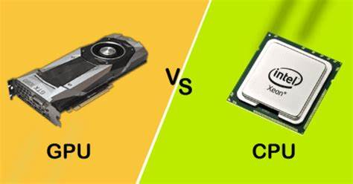
GPUS
Co – processor = “Any additional processor used for a specific task”
A co – processor’s purpose is to improve the overall speed of the computer executing concurrently with the main CPU
The GPU (Graphical Processing Unit) is a coprocessor with initially was used for rendering graphics as of the large number of cores it had for parallel streams of data to be processed at the same time but now it is not just limited to graphics.
GPUs typically run slower than a CPU as they are specialised and only superior in speed and efficiency in certain tasks where the CPUs are generic processing units.
CPUs – better for complex operations on small data sets
GPUSs- better for simple operations
GPUs are designed so a simple instruction can work quickly over a large block of similar data, repeating operations such as matrices/vectors and rendering graphics.
Rendering graphics can involve lots of parallel processing as each calculation is not dependent on other ones like RGB, XYZ positions and assigned textures which the GPU can perform well as it can perform thousands of floating-point operations much faster than the CPU.
But now, the GPU is used in oil exploration, weather modelling, linear algebra, statistical analysis, stock option predictions, gravitational field theory, machine learning.

Slide 15
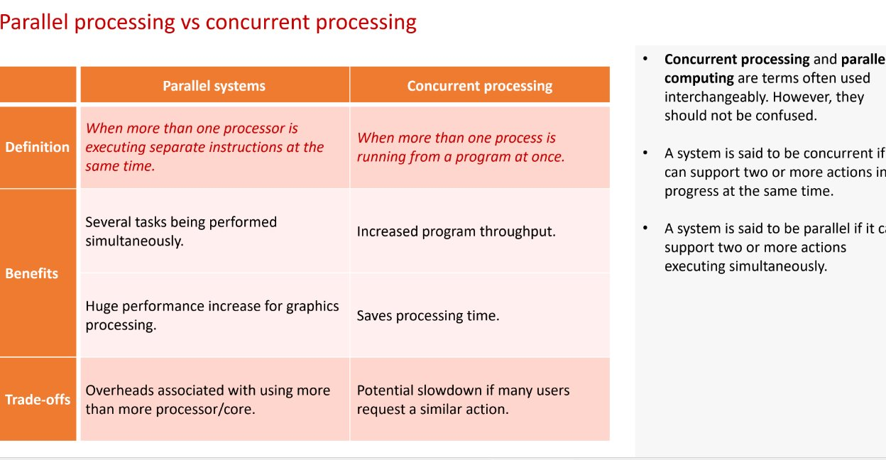
MULTI CORE AND PARALLEL
Another two ways to reduce demand on the CPU is multi-core processing and parallel processing.
A multicore processor is a single chip multiprocessor (CMP) containing two or more independent processing units.
The performance of multicore processors is enhanced by on-chips shared cache and inter core communication.
However, cores can be limited by overheads involved with inter-core communication and some programs can’t make max use of all cores.

Slide 16
SLR3 INPUT, OUTPUT AND STORAGE
MAGNETIC, OPTICAL, SOLID STATE
RAM AND ROM
VIRTUAL STORAGE
BARCODES

Slide 17

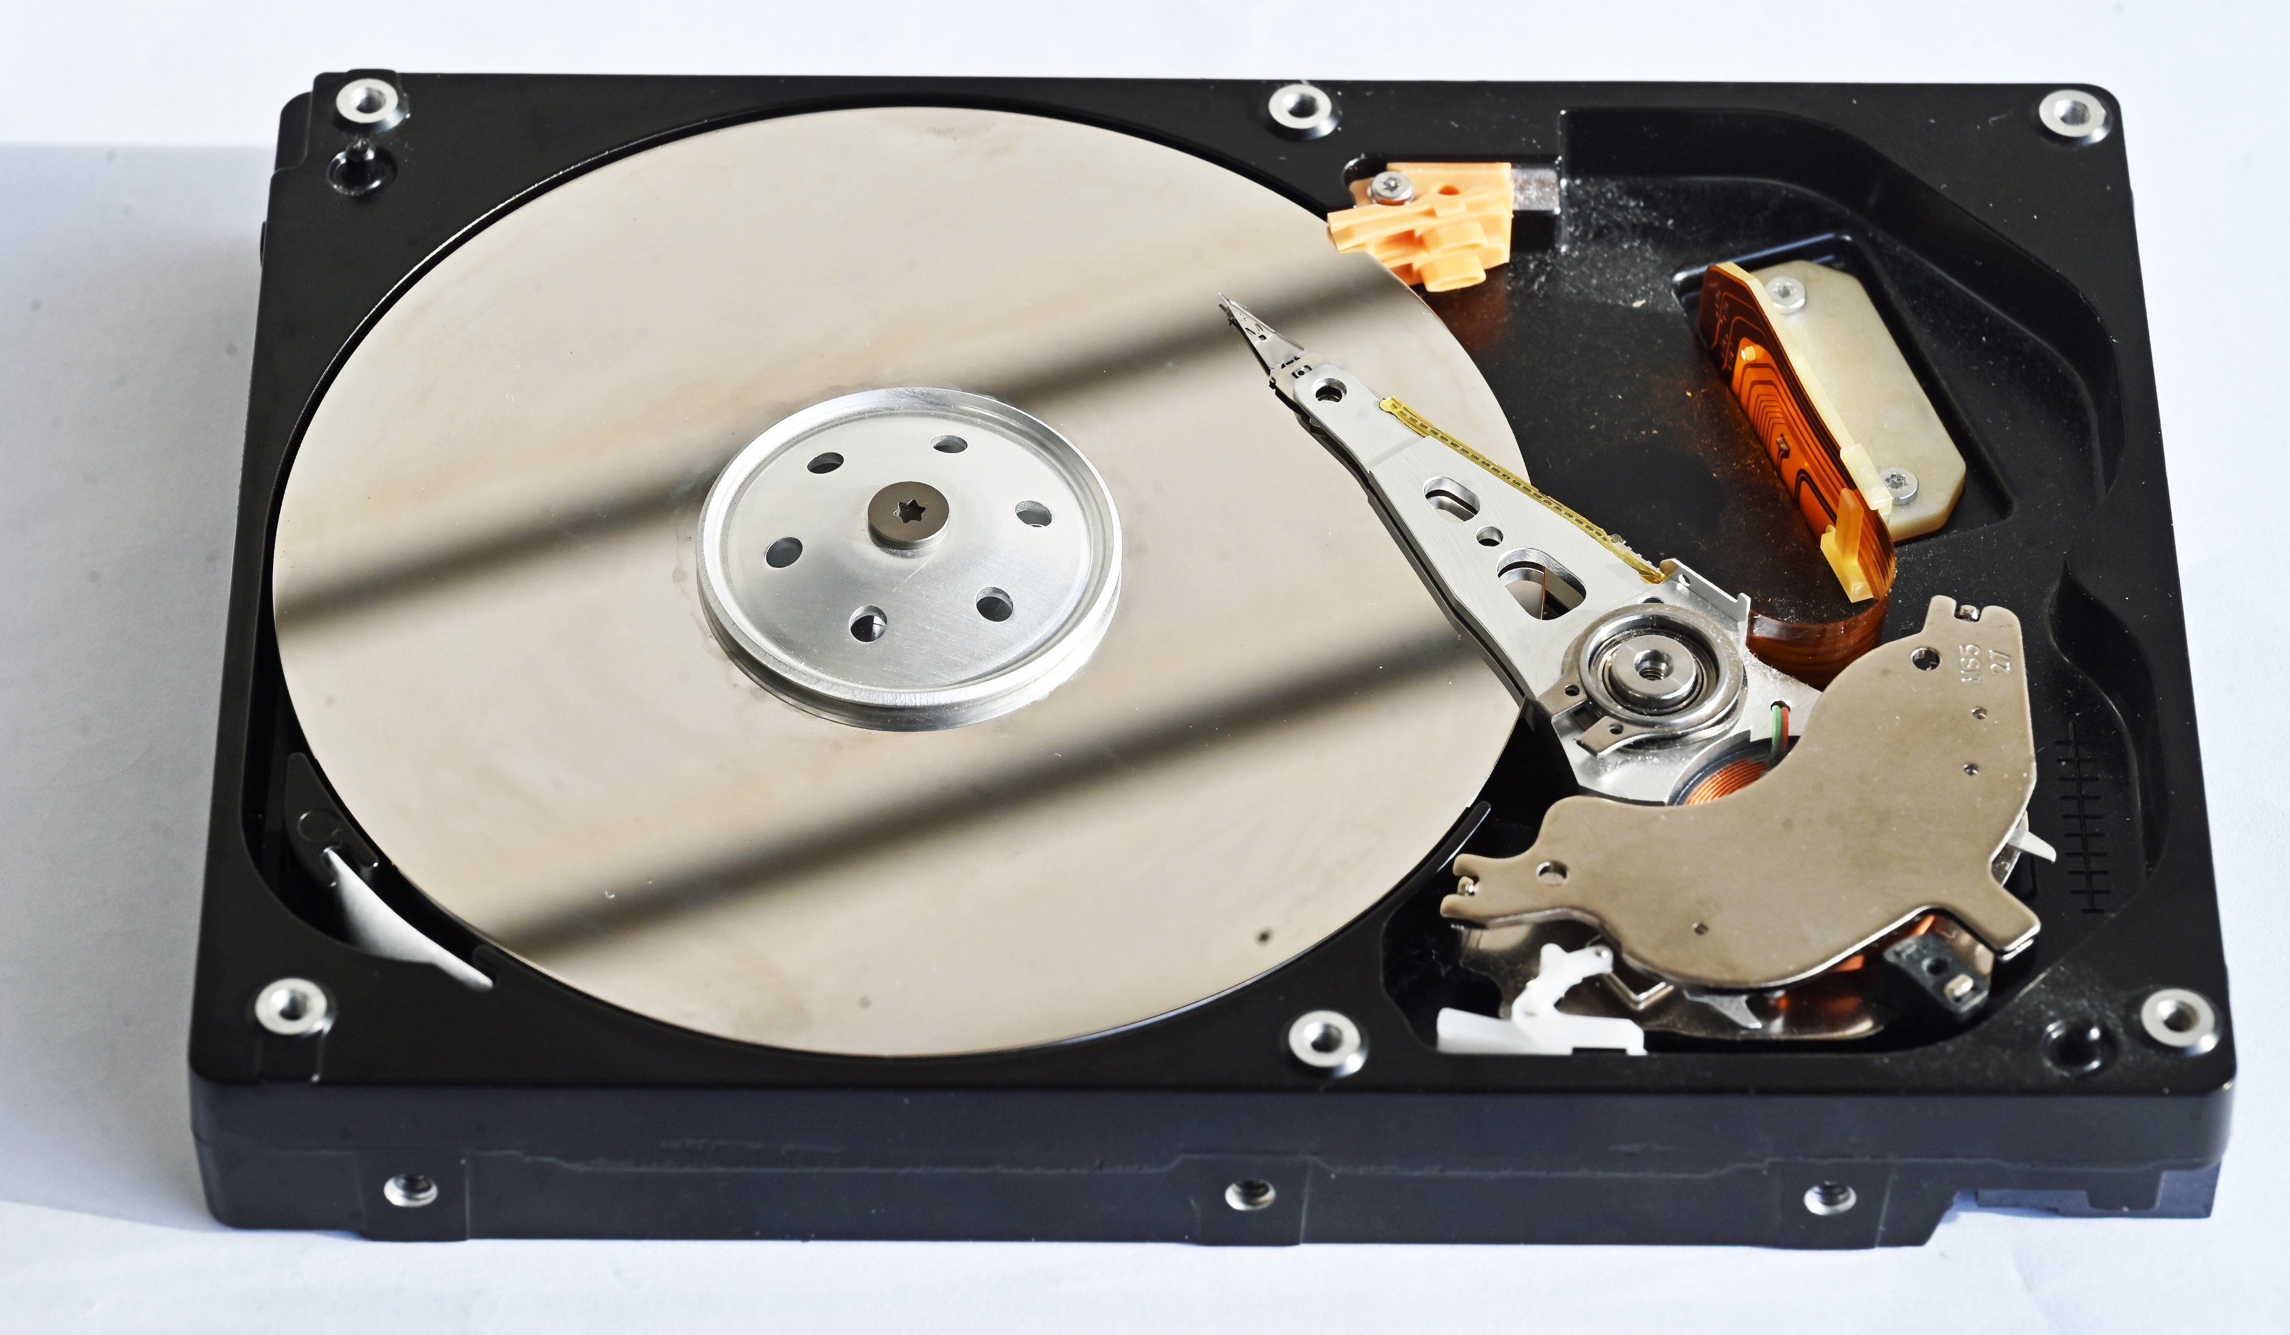

MAGNETIC, OPTICAL, SOLID STATE
Optical devices are read from and written using lasers with binary info being represented by portions of the disc that either reflect or scatter the incident laser light.
Magnetic devices which store information magnetically using magnetic states polarised and unpolarised to represent binary.
Examples are Hard Disk Drives, Magnetic Tape, Floppy Disks
Pros: Cheap, large capacity.
Cons: Slow access times, fragile, not robust
Examples are CDs, DVDs, Blu-Ray (in order of storage)
Pros: Portable, cheap.
Cons: Easily damaged, slow transfer speeds and limited storage capacity
Solid State (Drive) works by sending electrical currents to send electrons between oxide layers – does not have any moving parts.
Examples are USB flash drive
Pros: Durable, robust, fast access times, light
Cons: Expensive, limited read and writes due to oxide layer running out.

Slide 18
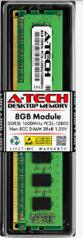
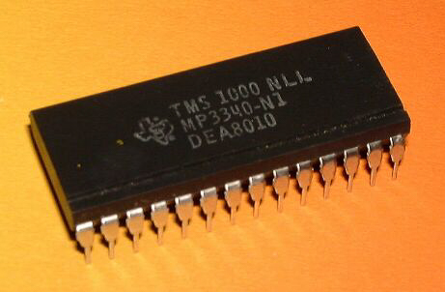
RAM AND ROM
RAM and ROM are types of internal memory/ primary storage used by the operating system to run a computer.
ROM (Read Only Memory) is not volatile so is used to hold information that needs to be permanently in memory like the bootstrap.
In embedded systems, the software never changes so is held in ROM as ROM cannot be modified as well.
RAM (Random Access Memory) is a type of fast main memory used to store data and program that the computer is currently using.
It speeds up computer’s execution as RAM has higher access speeds than even flash memory, but it is more expensive per GB than secondary storage devices.
RAM Is volatile so it loses all information when power is lost

Slide 19

VIRTUAL STORAGE
Files can be stored on “virtual servers” where cloud-based/ off site servers store information remotely so that is can be accessed by any computers with access to the same system
They have the advantage of:
- Reduced hardware costs
Improved reliability and performance
Flexibility to scale the storage requirements over time.
However, to access all your files and application, you need to rely on a fast Internet connection.
Also, separate backup plans are needed in the event of a hardware failure
Using a cloud storage provider may result in a loss of functionality and a compromise in your level of control
As well there is usually increasing fees the more you need to store on the virtual server.

Slide 20


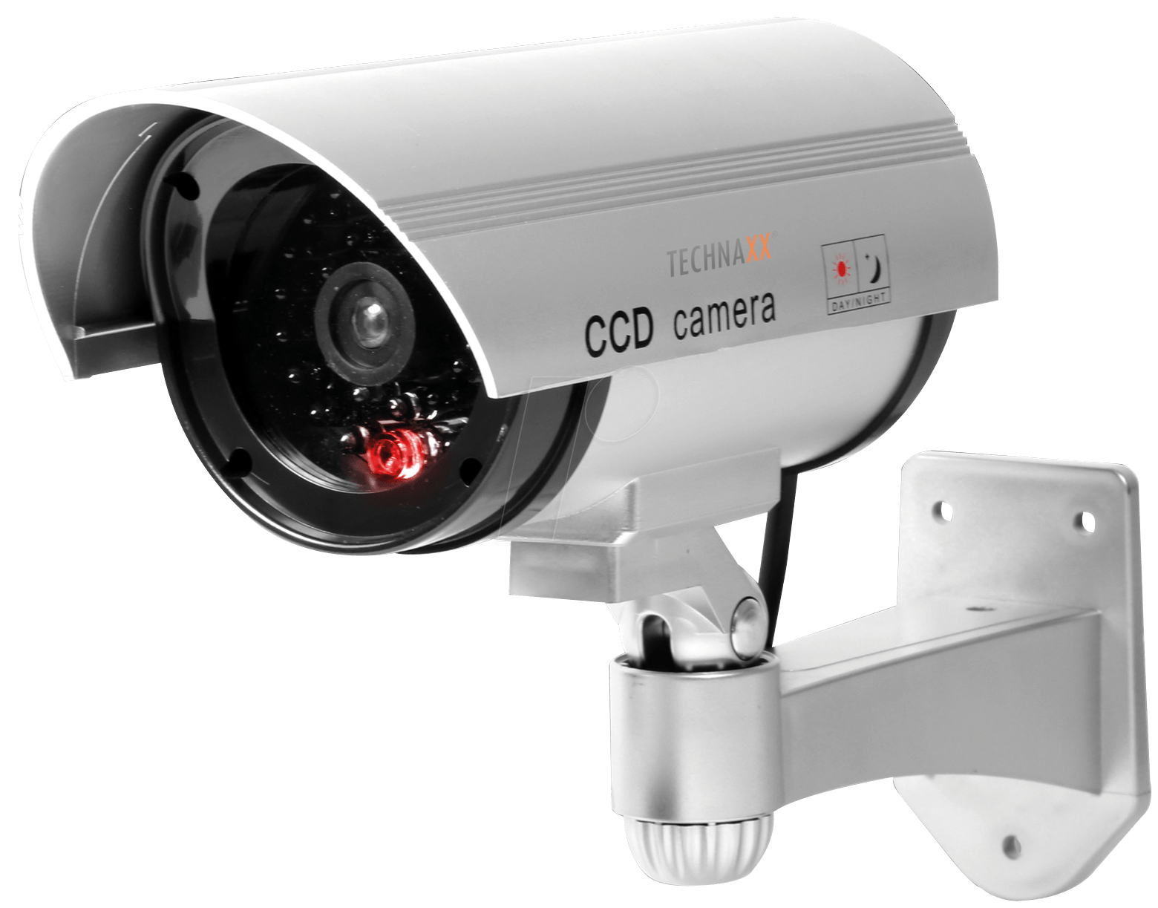
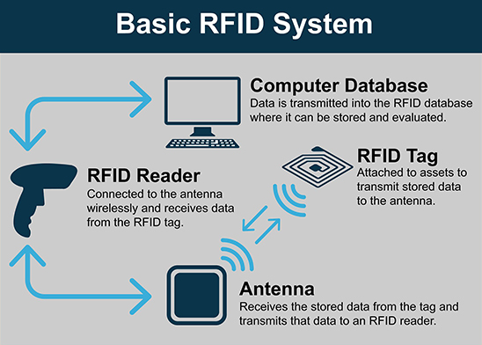
BARCODES
4 different types of barcodes: Linear and 2d (QR codes)
Types of barcode readers:
Pen type:
Uses a light source and a photo diode.
Durable, tightly sealed from environmental hazards, light.
Barcode must come into contact so is best suited for laptops.
Laser Scanner:
Use a laser beam as the light source.
Reliable and are most used in supermarkets
Camera Based Reader:
An imaging scanner uses a camera and image processing techniques to decode a barcode
Used in event ticketing, couponing, age verification (scanning driver licence), scanning QR codes.
Radio Frequency Identification (RFID)
RFID tags are used to tag and track objects or animals. Unlike barcodes, RFID tags can be read from 300 metres away
Active tags have a battery and are larger so they can actively transmit a signal.
Passive tags rely on radio waves from the reader to provide power.
Digital Cameras:
Uses a CCD or CMOS (Complimentary Metal Oxide Semiconductor) sensor comprising of millions of tiny light sensors in a grid.
Binary data from each sensor is recorded onto camera’s memory card so the image can be reproduced on any software.
It is used mainly in facial recognition

Slide 21
SLR4 OS AND SYSTEM SOFTWARE
FUNCTIONS AND PURPOSE OF OS
BIOS
MEMORY MANAGEMENT
DEVICE DRIVERS
INTERRUPTS
SCHEDULING
TYPES OF OS
VIRTUAL MACHINES

Slide 22



FUNCTIONS AND PURPOSE OF OS
User Management: Allows multiple users to log onto the same computer.
OS will retain setting and access rights for each user.
The Operating system refers to a collection of programs that work together to provide a user interface between the user and the hardware.
User interface: Provides the user an interface for application software and hardware.
They should have WIMP: Windows, icons menus and pointers.
Interfaces should be visual, interactive, intuitive and optimised for mouse or touch gesture inputs.
Multitasking: Having more than one program open and running at the same time can be done by the processor allocating a small amount of time to each process and cycles between them
Utility Programs:
Compression, encryption and defragmentation.
Interrupt handling: Deals with interrupts when any device requires the attention of the processor
Functions of OS
As it happens quickly, it seems as if multiple programs are running at the same time
Device Drivers: Peripheral hardware connected to the computer has its instructions transcribed by the OS
Memory/resource management: Storing data after power is lost, multitasking and virtual memory.
File Management: Sorting files, naming files, and where they are going to be loaded as of their extension in the filename like PNG or JPEG
Application Software: Word processors, spreadsheets, graphics programs are all run through the OS

Slide 23

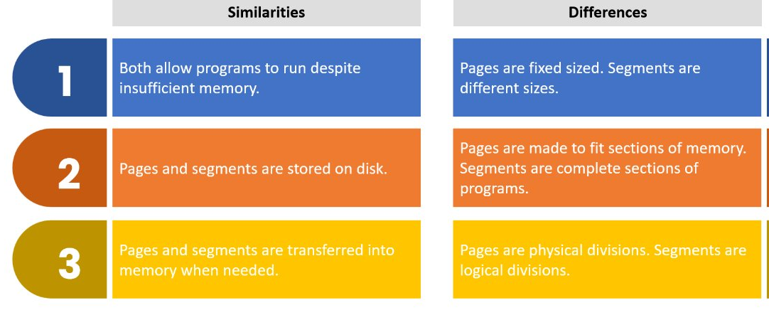
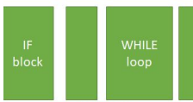
MEMORY MANAGEMENT
Virtual Memory: Uses a section of the hard drive to act as RAM when there is insufficient space in main memory. Pages and segments that are not currently in use are temporarily moved to free up RAM.
However, disk thrashing can occur if pages and segments are swapped too frequently between the hard disk and main memory.
This causes the OS to freeze and slows down programs.
Computer memory must be shared fairly between multiple programs and applications being used. The OS, to ensure main memory is shared efficiently and all programs are run, uses segmentation, paging and virtual memory.
Paging: When memory is split up into equal-sized sections physically known as pages which are a fixed size and can be swapped between main memory and hard disk as needed.
Segmentation: When memory is split into logical sized divisions known as segments with each segment being complete sections of code and can be representative of the structure and logic of a program. They can be swapped between main memory and hard disk as needed

Slide 24
Interrupts are also regularly tiggered at times to indicate that it is turn of the process to have processing time. It is because a processor can be interrupted that multi-tasking can occur.
INTERRUPTS
An interrupt is a signal from a software program, hardware device or internal clock to the CPU.
Software interrupt: An application program terminates or requests certain services from the OS.
Hardware interrupt: When an Input/Output operation is complete or a peripheral error.
When the CPU receives an interrupt signal, it suspends current execution of program and disables all interrupts of a lower priority.
Then, puts the values of the Program Counter and registers onto the system stack while the Interrupt Service Routine is called to deal with the interrupt.
Interrupts have different priorities, and lower priorities may be disabled if a higher priority interrupt needs to be serviced
Once an interrupt has been serviced, the original values of the registers are retrieved from the system stack, the process resumes.
A test for the presence of interrupts is carried out at the end of each FDE cycle as well
Power fail interrupt
Clock interrupt
An I/O device sends a signal requesting service
PRIORITY
No
Any interrupts to be processed?
FDE cycle
Transfer control to the IHS
Start
Yes

Slide 25
SCHEDULING
Pre-emptive:
Jobs are actively made to
start and stop by the OS
A scheduler manages which process to run next and
the length of time the next process can execute for.
Non-pre-emptive: Jobs are started and then left alone until it is completed.
Round Robin: Each process is allowed a fixed amount of time called a time slice/quantum. After their time is up, they must re-enter the queue if the process is not fully executed.
First come, first serve: Processes are executed in the order they arrive.
Shortest remaining time: The queue is based on which process are closest to complete.
There is a risk of processor starvation for longer jobs if short queues are added to the job queue
Scheduling algorithms:
Shortest job time: The process with the smallest estimated running time is run next
Very similar to shortest remaining time.
Multi-level feedback queues: If a computer has more than one core, it can use multiple queues, each which is ordered based on a different priority.
This can be difficult to implement due to deciding which job to prioritise based on a combination of priorities.

Slide 26




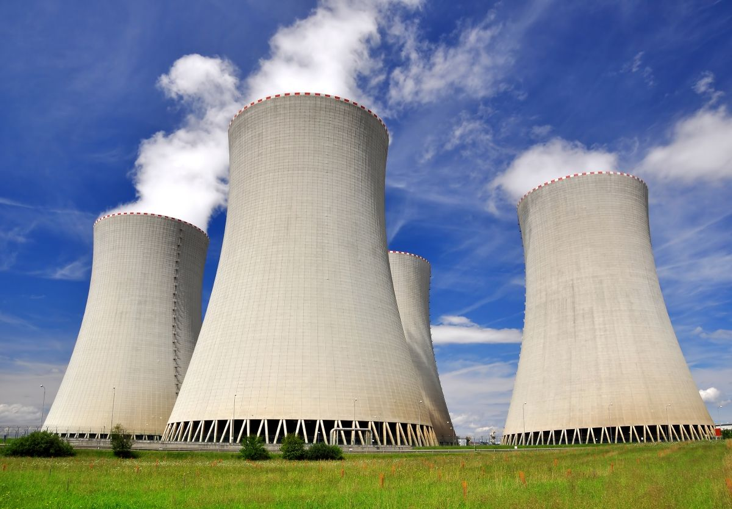
A distributed operating system is a form of parallel processing system which spreads the load over multiple computer servers. For example, Linux has a distributed version
This is co-ordinated by the operating
system to make it look like a single system.
TYPES OF OS
Real Time systems are safety critical and must respond very quickly to any inputs or sensors and it must be able to deal with many inputs simultaneously.
Failsafe and extra components (redundancy) must be incorporated.
Rockwell Collins AFDS-770
For example, is used for autopilot
Multi-user systems involve a single powerful mainframe that is connected to dozens of terminals all using them mainframe CPU.
Each get a time slice of processing based on scheduling
The main computer can be called a big iron
Multi-tasking Systems may run on a single computer and can run many jobs simultaneously, switching between them.
E.G ORBIS and Windows
Embedded operating systems are smaller systems with minimal user interfaces and a limited amount of RAM
No permanent data storage devices to be managed with no complex memory management.

Slide 27

VIRTUAL MACHINES
A virtual machine is a theoretical computer in that it is a software implementation of a computer system. It provides an environment with a translator for intermediate code.
Intermediate code: Code that is halfway between machine code and object code. It is independent of the processor architecture so can be used across different machines and operating systems.
VMs are commonly used to create a development environment for programmers to test programs on different Operating System. This saves time and money by not having to buy multiple devices just for their OS.
However, running intermediate code on a VM can be considerably slower compared to running low level code on the device it was designed for.
VMs other uses include:
PROTECTION FROM MALWARE:
Malware will affect the virtual machine rather than the device being used.
RUNNING INCOMPATIBLE SOFTWARE:
Programs specific to different OS or different versions of an OS can be run within a VM – saves time and money.
For example, games consols being implemented on PCs.

Slide 28
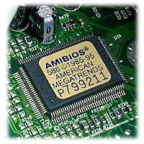
BIOS
BIOS (Basic Input/Output System) is a piece of firmware that initialises and tests the hardware in a computer.
It is stored on a non-volatile ROM memory chip on the motherboard and is the first software to run when systems start.
It performs a POST (Power-On-Self-Test), a diagnostic testing sequence that ensures all hardware component are working properly.
If the BIOS encounters any errors during this test, it will either halt the process or issue an error message
If the POST succeeds, the BIOS will run the bootstrap loading sequence which is responsible for starting the operating system by loading it from the hard disk into RAM

Slide 29
DEVICE DRIVERS
Device drivers are computer programs which are provided by the OS and allow the OS to interact with hardware.
The device driver translates the OS’s instructions to an external peripheral such as a printer and the device driver communicates the request of the hardware to the OS.
Device drivers are specific to the computer’s architecture so different drivers must be used for different device types.
As drivers interact with the OS, they are also specific to the OS installed on the device
Device drivers are an example of abstraction as you as a user can interact with hardware without knowing details about how this works.

Slide 30
SLR 5 APPLICATION GENERATION
OFF THE SHELF AND BESPOKE SOFTWARE
NATURE OF APPLICATIONS
UTILITIES
OPEN SOURCE AND CLOSED SOURCE
TRANSLATORS
COMPILATION
LINKERS LOADERS AND LIBRARIES

Slide 31
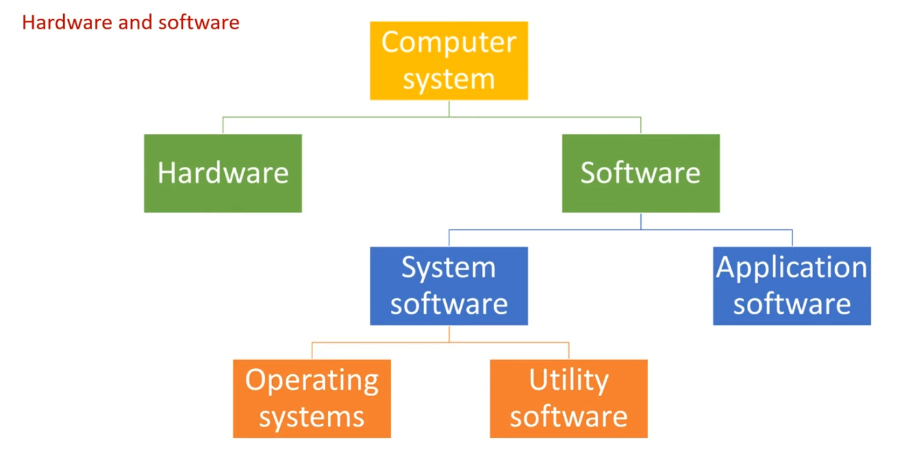
NATURE OF APPLICATIONS
General-purpose software: Word-processor, spreadsheet, graphics package are example as they can be used for many different processes,
Specific-purpose software: Fingerprint scanners, hotel booking systems, payroll as they are all designed for a single task. This software may be bought off the shelf or bespoke.
Systems Software is a low-level software that is needed to run the computer's hardware and application programs.
This includes the Operating System, utility programs, libraries and translators.
Application software is software designed to be used by the end-user to perform one specific task.
Application software requires system software, an example would be spreadsheets, web browsers etc.

Slide 32
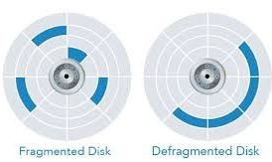
UTILITIES
Utilities are part of system software that handles ensuring consistent, high performance of the OS. Each utility program has a specific function linked to the maintenance of the OS.
Disk defragmentation: As the magnetic hard disk becomes full, read/write times slow down as files become fragmented as they are stored in various parts of memory.
Disk defragmenter utility rearranges the contents of the hard drive, removing free spaces and moving files closer. This means files can be accessed faster as the movement of the read/write head is reduced.
Compression: Compressing larger files to be transmitted across the Internet so they can be transported quickly.
Antivirus: Is responsible for detecting potential threats to the computer, alerting the user, and removing these threats.
Automatic Backups: Automatically creates routine copies of specific files selected by the user.
How often files are backed up and where to is also specified by the user so important files to user can be recovered easily.
Automatic updating: Makes sure any software installed is kept up to date by installing updates automatically when the computer is restarted.
Firewalls and antivirus software need to be regularly updated as of new threats being constantly used.

Slide 33


OPEN SOURCE AND CLOSED SOURCE
Note: Freeware is free to use but no access to source code
Source code is written by a programmer and refers to object code before it has been compiled.
Closed source/ proprietary software is sold in the form of a licence to use it.
There will be restrictions on how the software can be used, users cannot access the source code, and the company owns the copyright licence
Open-source code can be used by anyone without a licence and is distributed with the source code.
Developers can sell the software they have created with open-source code and any new software created from open-source software must also be “open” (able to be modified by anyone.)
Closed +
Regular, well-tested updates.
User manuals and expert support provided.
High levels of security.
Closed –
Licence may restrict how many people can use the software at once.
Users cannot modify/improve software themselves.
Open +
Can be improved/modified by anyone.
Technical support from online community.
Can be modified and sold.
Open –
Support available online may be insufficient or incorrect.
Lower security as not developed in controlled environment.

Slide 34
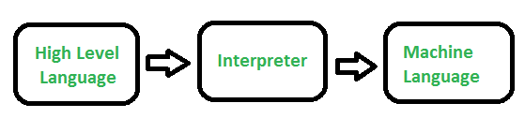
TRANSLATORS
Translators convert high level source code into low level object code, which is then ready to be executed by a computer
Interpreters translate and executes code line by line and stops and produces an error if a line contains an error.
Initially appear faster as code is instantly executed by slower than running compiled code as code must be translated each time it is executed with an interpreter.
They are useful for testing sections of code as time is not wasted compiling the entire program.
Interpreted source code can be run on any machine as it has platform independence.
A compiler translates high level code all at once, after carrying out several checks and reporting back any error.
Object code can be saved on disk and run whenever required without the need to recompile.
It executes faster than interpreted code and a compiler is not needed when the object code is executed and is more secure.
Best used for a program that runs frequently with only occasional change or when the object code is distributed out of the company as source code is not present.
An assembler translates assembly code into machine code, or an intermediate form called bytecode.
Each line of assembly code is equivalent to one line of machine code, so code is translated on almost a one-to-one basis.

Slide 35

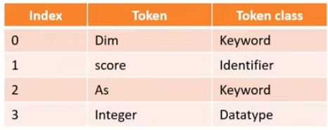
COMPILATION
LEXICAL ANALYSIS
Whitespace and comments are removed from the code
The remaining code is analysed for keywords and names of variables and constants. These are replaced with tokens and information about the token associated with each keyword or identifier is stored in a symbol table.
SYNTAX ANALYSIS
Tokens are analysed against the grammar and rules of the programming language. Any tokens that break the rules of the programming language are flagged as syntax errors.
Semantic analysis is also carried out where logic mistakes within the program are detected.
An abstract syntax tree is produced at the end of this stage, a representation of the source code.
OPTIMISATION
Searches code for areas that could be more efficient, so code is faster to execute. Insignificant, redundant parts of the code are detected and removed. Repeated sections of code may be grouped and replaced with more efficient code which produces the same result.
However, excessive optimisation may alter how the program behaves.
CODE GENERATION
Abstract syntax tree produced is used to produce machine code.

Slide 36
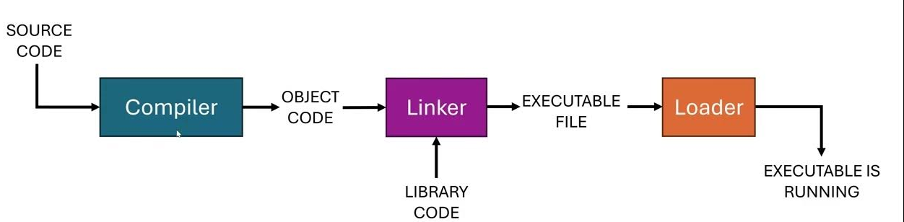
LINKERS LOADERS AND LIBRARIES
Linkers can be static (libraries are added to the main file) or dynamic (libraries addresses are referenced in code
Any separately compiled subroutines must be linked into the object code. The linker puts appropriate machine addresses in all external call and return instructions so that the modules are linked together correctly.
Loaders are programs provided by the OS. When a file is executed, the loader retrieves the library or subroutine from the given memory location
Libraries are pre-compiled programs which are ready to use and error free, saves time developing and testing modules.
They can be re used in multiple programs and offer a specialised range of functions.
Examples include mathematical and graphical functions

Slide 37

OFF THE SHELF AND BESPOKE SOFTWARE
OFF THE SHELF | BESPOKE
General, ready to use software | Software custom made to fit requirements
May contain a lot of unwanted features and some desirable features may be missing | Features customised to user requirements and other features can be added as needs arise
Less expensive | More costly and requires expertise to analyse requirements
Ready to be installed instantly | May take a long time to develop
Well documented, tested, error free | May contain errors which do not surface immediately

Slide 38
SLR6 SOFTWARE GENERATION
SDLC
EXTREME PROGRAMMING
TESTING
WATERFALL
AGILE
SPIRAL
RAD

Slide 39

SDLC
Analysis:
Stakeholders' states what they require, the info is used to clearly define the problem and system requirements.
Consider inputs, outputs and storage of data.
Analyse strengths and weaknesses of current solution.
Software development life cycle follows these stages when software is being developed
Maintenance:
Any errors or improvements that can be made to the software are flagged up by the end-users. Regular software updates are sent out to fix bugs and security issues.
Design:
Designs of the following are usually created:
Inputs, outputs, security features, hardware, user interface, processing, data structures, compatibility.
SDLC
Evaluation:
The effectiveness of the software is evaluated against the system requirements defined in Analysis.
Different criteria are considered e.g. robustness, portability, reliability, maintainability.
Development, Testing and Implementation:
Design is coded in modules, tested and then when all is satisfactory, the software will be installed on the user’s system.

Slide 40
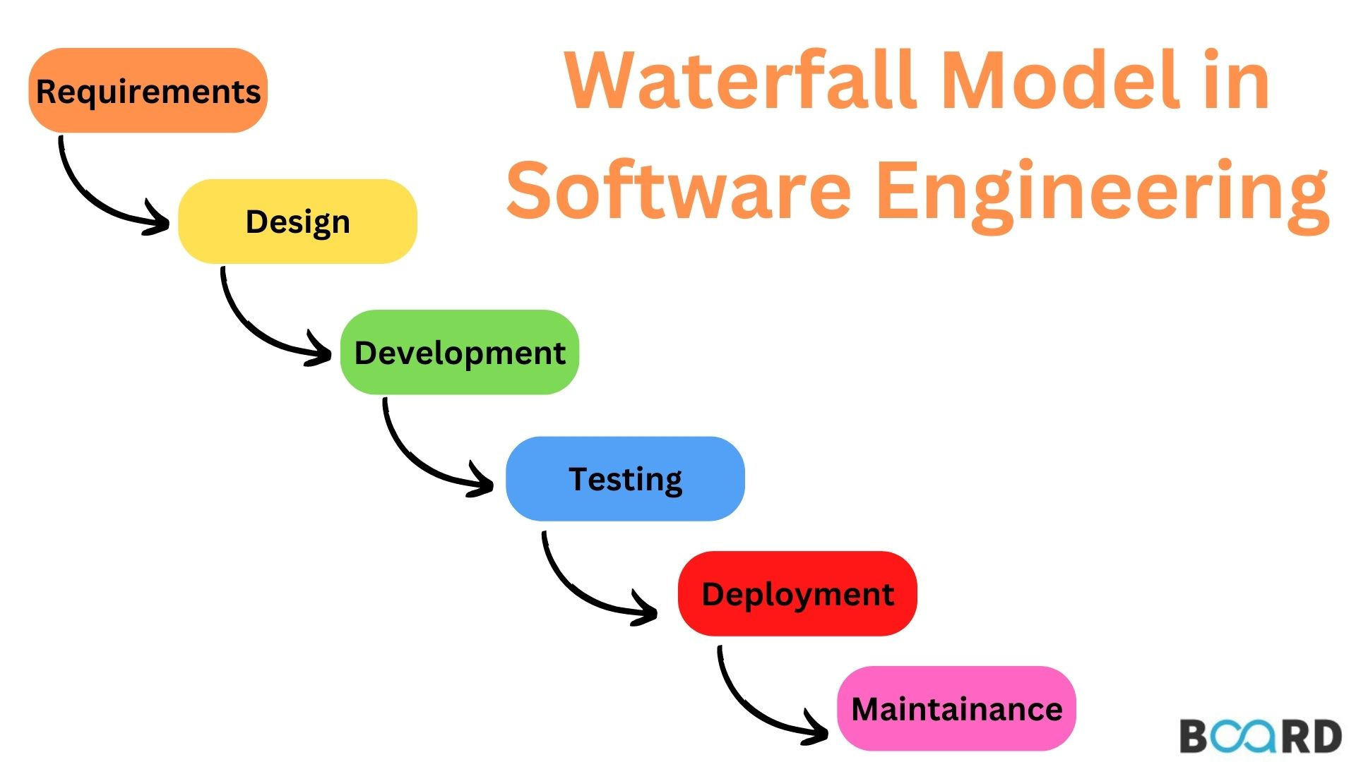
WATERFALL
The waterfall methodology is where each step is completed individually from beginning to end with clear documentation
Each step has specific outputs that lead into the next step
It is possible to move back up the stages as well
The user is involved heavily at the start of the process (Analysis) but there is a little input at the end (Evaluation)
The model is inflexible and unsuitable to projects with changing requirements. No risk analysis as well
It is suitable for small and low risk projects e.g. student projects.
The absence of user involvement is a serious drawback

Slide 41
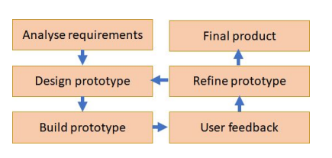
AGILE
An agile approach/methodology involves an iterative process where feedback will be continually gathered as the software is being developed.
The stages of a software may not be completed in a linear sequence, and its aim is to improve flexibility of software development
This approach can adapt to changes in user requirements faster
The problem is broken into sections which are developed in parallel.
Prototypes are created to ensure the software meets the requirements and are delivered regularly to the user over the development cycle.
Less of a focus on documentation, priority is given to user satisfaction
The success of the development depends on:
Keeping model simple
Rapid feedback
Understanding requirements may change
Incremental changes as the model develops.

Slide 42
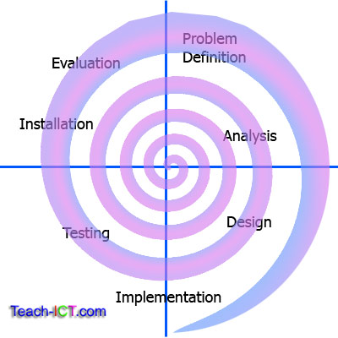
SPIRAL
The spiral model uses the same structured steps as in waterfall, but development is iterative.
Each successful cycle around the spiral generates a refined prototype until the product is finished
It is mostly used for large scale products with changing requirements over that period
In comparison with agile, they are both adapted for clients with changing requirements but agile is more suited for smaller projects due to modules being developed in parallel
It effectively manages and mitigates risks. However, hiring risk assessors to analyse the risks involved can be expensive.
If project is found to be too risky = project terminated.

Slide 43
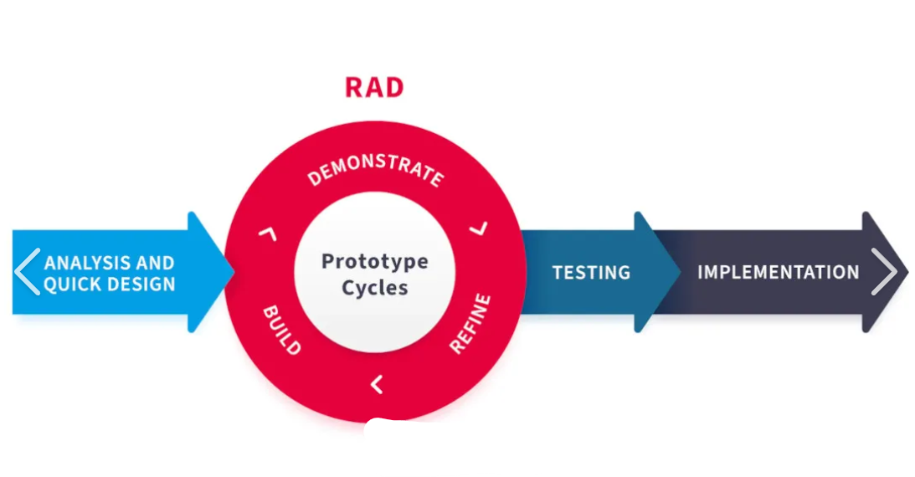
RAD
Rapid application development is an iterative methodology which uses partially functioning prototypes that are continually built upon. Focus is kept on core features
Workshops and focus groups are used to gather initial requirements and feedback from partially completed solutions before they are improved using the feedback.
The prototype is continually refined with each prototype having a strict time limit.
This is commonly used where user requirements are unclear or incomplete at the start whilst focusing on fast completion of large projects as well.
It prevents the danger of getting sidetracked by having developers "chase a moving a target"
Reusing of code is vital for saving time however constant additions to a prototype can make code inefficient.

Slide 44
EXTREME PROGRAMMING
This is an agile framework involving regular, small, iterative software releases.
It aims to produce very high-quality code and promotes collective ownership and teamwork.
Extreme programming core practices:
Best suited for medium requirement that need excellent usability.
Requires teamwork and clear communication between team members and the user.
Excessive costs potentially due to more programmers needed.
Continuous integration
Code standards
Paired programming
Collective code ownership
Refactoring ( Improving design, preserving function)

Slide 45

TESTING
Black box testing:
Internal structure is not shown to testers and can be carried out by anyone. It traces inputs and outputs within the program.
Programs need to be tested against the test plan formed in the design stage of the SDLC so all errors can be discovered and corrected before the software is installed
Alpha testing:
Carried out by software developer's own testing team. Often reveals errors and omissions in the system requirements definition.
White box testing:
Form of testing carried out by software development teams with test plan being based on the internal structure of the program and the corresponding logic. All possible routes through the program are tested. A weakness is that missing functions may not be detected in this type of testing.
Beta testing:
Carried out by end-users after alpha testing. Exposes the product to real use and reveals unanticipated problems to developers.

Slide 46
SLR7 PROGRAMMING LANGUAGES
PROGRAMMING PARADIGMS
PROCEDURAL
ADDRESSING METHODS
ASSEMBLY
OOL

Slide 47
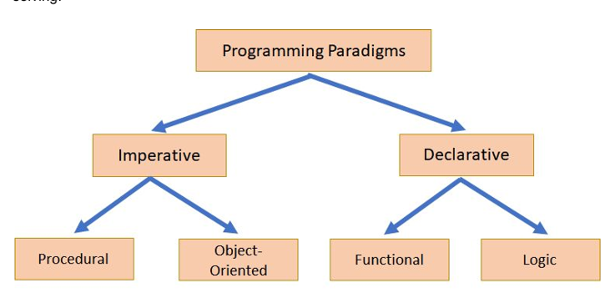
PROGRAMMING PARADIGMS
A paradigm is a style of computer programming
A language is the specific syntax to write code
High level languages broadly fit into two paradigm categories:
IMPERATIVE: Use statements that change a program’s state in the form of sequence selection iteration etc. Consist of commands for a computer to perform, describes how a program operates
DECLARATIVE: Focuses on what the program should accomplish. Do not need to cover much about it but SQL is an example and it is also used in AI.
Some languages e.g. Python can support more than one programming paradigm.
Imperative Paradigm examples:
Procedural: Where a program is built from functions, sequence, selection, iteration etc. Relatively easy to write and interpret. Instructions are carried step by step.
E.g. Python, Pascal, C
Object-Orientated: Makes code reusable and easy to maintain by focusing on a more modular approach to programming. It is built from classes, objects, attributes and methods.
E.g. Java C#

Slide 48
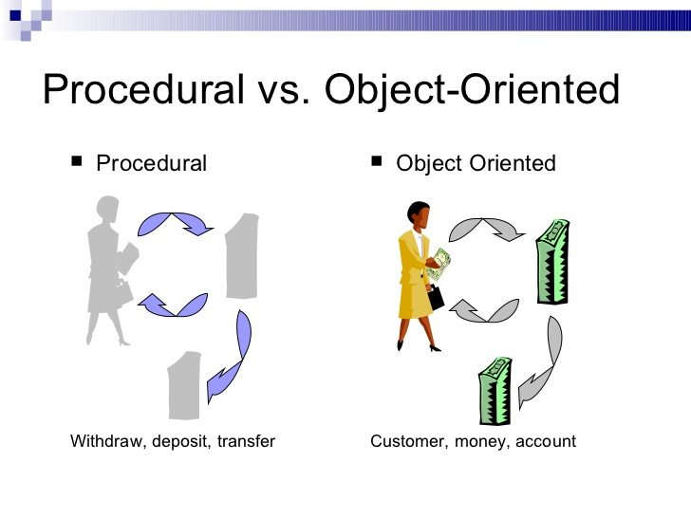
PROCEDURAL
Procedural programming is used for a wide range of software development due to its simplicity however it is not possible to solve all problems with these languages, or it may be too inefficient
They use traditional data types and provide data structures like arrays.
Sequence, selection, iteration and recursion are the main 4 programming structures
For abstract data structures however like stacks, it can be implemented in many ways, but every programmer must write specific subroutines for each structure they create which can be inefficient.
The solution is Object Orientated Programming.

Slide 49
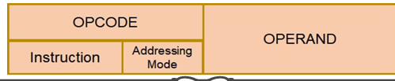
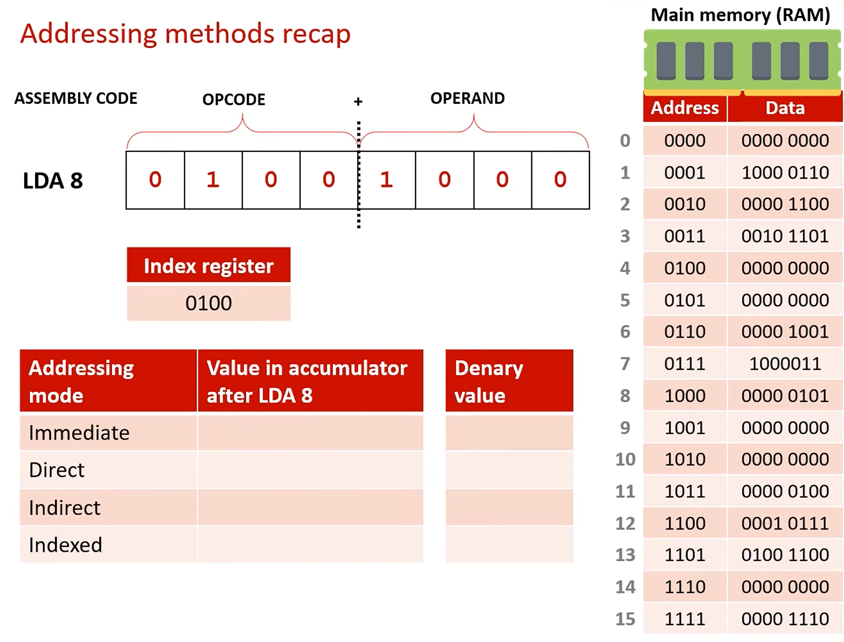
ADDRESSING METHODS
Machine code instructions are made of opcode and operand.
Opcodes specifies the instruction to be preformed; operand holds a value related to the data on which the instruction is to be performed.
Usually, the operand holds the address related to where the data is stored.
Addressing modes allow for a much greater number of locations for data to be stored. The addressing mode specifies how the opcode should be interpreted
0000 1000 8
0000 0101 5
IMMEDIATE: Operand is the actual value to be operated on. Operand 1000, value is 8
0000 0000 0
0001 0111 23
DIRECT: Operand holds memory address of value to be operated on, is used in LMC. Operand 1000, go to memory address 8, value 5
INDEXED: Address of value obtained by adding index register value to operand. Necessary to add an offset to access data stored contiguously like array.
Operand 1000, index register 0100, go to memory address 12, value 23
INDIRECT: Operand holds the location of the address of the value. Operand 1000, go to memory address 8, value 5, go to memory address 5, value 0

Slide 50

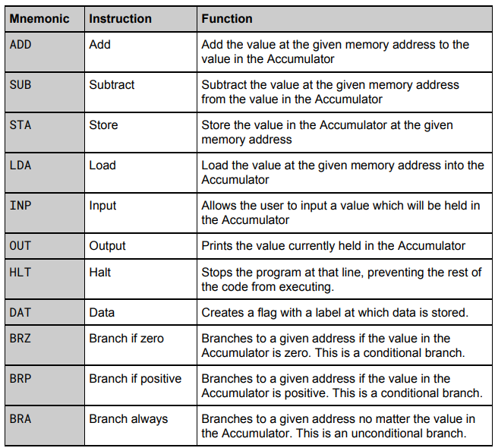

ASSEMBLY
LMC PROGRAM TO WRITE MOD IN A LOW-LEVEL LANGUAGE
Assembly language is the next level up from machine code and is a low-level language. This code is converted to machine code using an assembler when it is executed.
Assembly language uses mnemonics rather than binary which makes it easier to use than direct machine code.
However, the commands that assembly language uses are processor specific as it directly interacts with the CPU’s special purpose registers. This allows for direct interaction with hardware so is useful in embedded systems.
LMC uses assembly as well.
INP
STA num1
INP
STA num2
LDA num1
positive STA num1
SUB num2
BRP positive
LDA num1
OUT
HLT
num1 DAT
num2 DAT
Branches back to the “positive” flag when num1 – num2 is positive – essentially dividing num1 by num2 with num1s last value being the remainder.

Slide 51
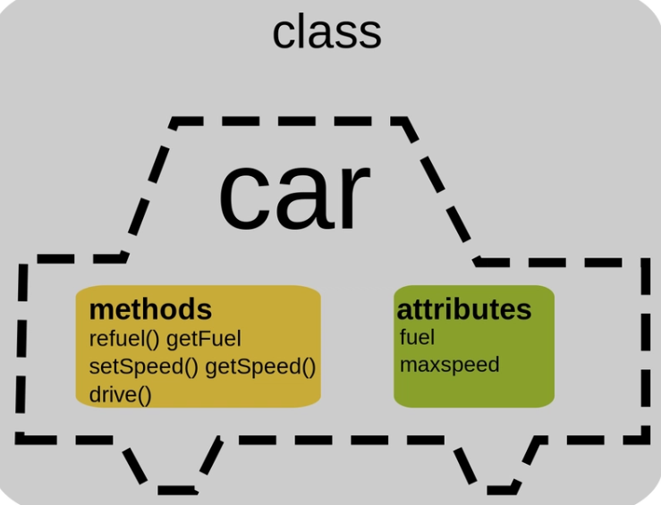
OOL
Object Orientated Languages involve defining a class which is a blueprint containing the description of what the data looks like (STATE) and what it can do (BEHAVIOUR.) Data items are called objects which are instances of a class.
Attributes control state and methods control behaviour. Attributes are usually set to private whilst methods are usually public. Objects share the same methods and attributes but may have different attribute values.
A main benefit of OOLs/OOP is encapsulation. An object encapsulates its attributes + methods so the changing of one attribute in one object does not change the other. Multiple programmers can work on different classes and not have to worry about how one class affects the other classes as each object encapsulates its methods and attributes.
Instantiation: A constructor is used to create objects from a class. In pseudocode, a procedure called “new” is the constructor E.g.
BOOK1 = new Book(“Computer Science”, 128)
Object = new Class(Attributes)
Messages in object orientated programming can be “getter” messages involving functions and retrieving values or “setter” messages involving procedures and setting attributes to a particular value. This is used so attributes cannot be accessed and edited directly by users.

Slide 52
OOL CONTINUED
Inheritance is where classes can inherit data and behaviour from a parent class. Subclasses inherit from super classes
Animal
E.g. in this inheritance diagram the dog and cat classes may have the same methods (Moving(), Jumping()) and same attributes (Size) which are all derived from the superclass Animal. However, may have different, new methods like dog having a method Bark() or a cat having a method Meow().
Cat
Dog
Advantage of OOLs:
Encapsulation protects attribute making code more reliable
Modular structure makes code easy to maintain
Allows for high levels of reusability
High level of abstraction
Classes can be used across multiple projects
Good framework for code libraries
Disadvantages:
Requires an alternative style of thinking
Not suited to all types of problems e.g. a project with little reusing of components.
Generally unsuitable for smaller problems
Polymorphism refers to a programming language’s ability to process objects differently depending on their class; therefore, the same method can give different outputs.
This is mostly done by overriding existing methods inherited from the superclass via creating a new method with the same name and formal argument types. E.g. cat’s Moving() method allows it to move 2 steps, whilst dog’s Moving() method allows it to move 3 steps.

Slide 53
SLR9 CEH
COMPRESSION
ENCRYPTION
HASHING

Slide 54
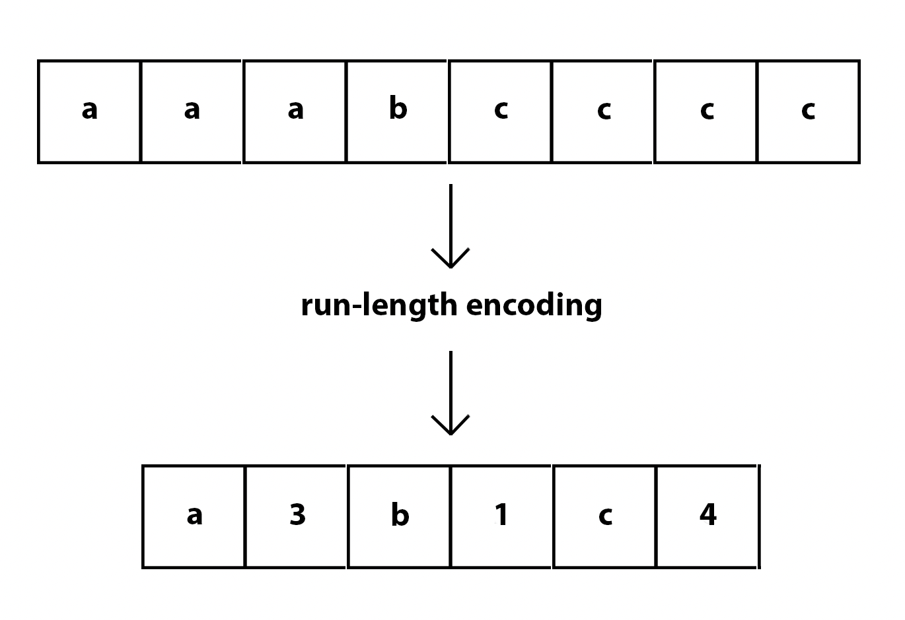
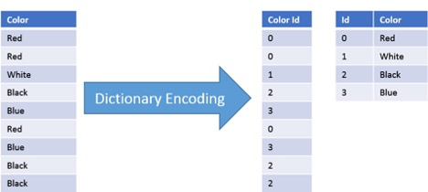
COMPRESSION
Lossy compression works by removing non-essential information.
Used for sound, images and video files.
Process used to reduce the storage space required by a file. Particularly important when sharing files over networks or the internet.
Larger files take longer to transfer, compressed files therefore take less time to transfer
Run length encoding is where repeated values are removed and replaced with one occurrence of the data followed by the number of times it should be repeated - lossless
Lossless compression, the original file can be recovered from the compressed version with no data lost
Used for program files and text files as all data must be recovered when the program is decompressed.
Dictionary based compression is where the compression algorithm searches through the text to find suitable entries in its own dictionary and translates the message accordingly - lossless

Slide 55
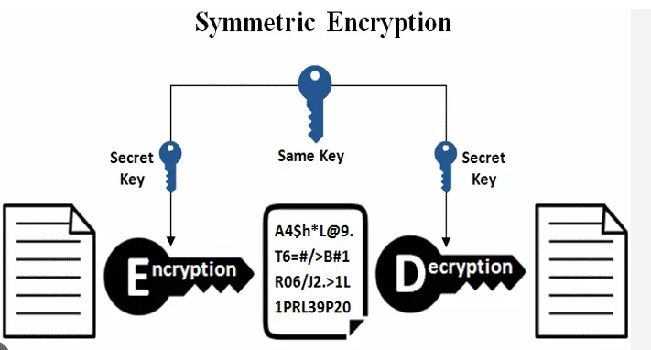
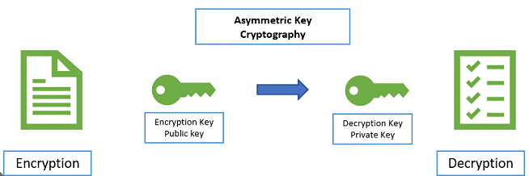
ENCRYPTION
Symmetric encryption uses the same key to encrypt and decrypt data. It is a private key that is transferred via a key exchange between the sender and receiver.
The key can be intercepted as easily
as the ciphertext message to
decrypt the data – security issue
The key MUST be kept private
Encryption is the transformation of data to prevent an unauthorised third party from being able to understand it.
Original data = Plaintext
Encrypted data = Ciphertext
Encryption method = Cipher
Info to lock or unlock the message = Key
Asymmetric encryption uses two separate but related keys, one public, one private.
The public key is made public so that others wishing to send you data can use this to encrypt the data.
The private key is known only by you and can only be used to decrypt the data. The private key cannot be deduced from the public key making this very secure
Even if the ciphertext is intercepted, it cannot be deciphered without private key
However, a message could be encrypted using the public key and maliciously sent to you from an impersonator – to prevent this a message can be digitally “signed” to authenticate the sender

Slide 56
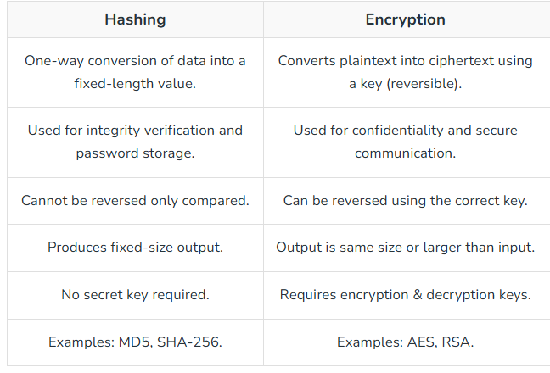

HASHING
Hashing is the process in which an input (key) is turned into a fixed size value (hash) using a hash function.
The output of a hash function cannot be reversed to form the key – makes it useful for storing passwords.
When password entered, password hashed and checked against key to see if it is correct – a hacker could only gain access to the keys.
Hash tables are data structures which holds key-value pairs. Formed via an array + hash function, they can be used to lookup data in an array in constant time.
They are best when lots of data needs to be stored with constant access times e.g. caches, databases.
Good hash function:
Low chance of collision
Quick to calculate
Provide an output which is smaller than the input.
Collisions are where two keys produce the same hash – this can be overcome by storing the items together in a list under the hash value or using a second hash function.

Slide 57
SLR10 DATABASES
RELATIONAL DATABASES
MANAGING DATA
NORMALISATION (DATABASES)
SQL
REFERENTIAL INTEGRITY

Slide 58
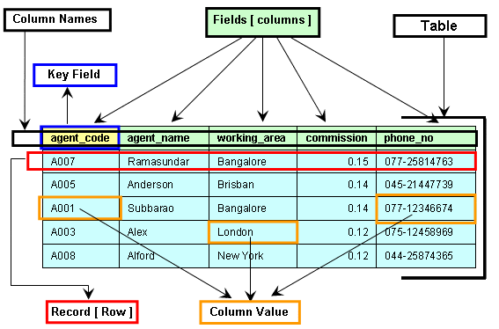
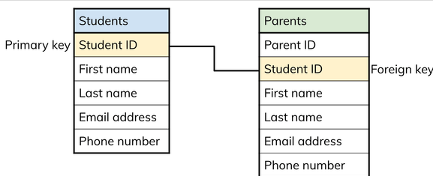
RELATIONAL DATABASES
In relational databases, data is held in tables, and the tables are linked by means of common attributes.
Entities are a category with attributes.
FOR EXAMPLE, Entity = Movies, Attribute = Movie Name
Flat file databases consist of a single table and entity and can be created very easily.
Relational databases can be written as
Students(Student Id, FirstName LastName ….)
PRIMARY KEY UNDERLINED
They are saved as a CSV (Comma separated values)
They are quick to set up, little expertise needed to maintain and suitable for storing small amounts of data – not good for large amounts of data and multiple entities
A primary key is a unique identifier for each record in the table; secondary keys also are used.
Foreign key is the attribute which links two tables together.
Composite key is where a primary key consists of two or more attributes
The relationship between entities can be modelled graphically:
A
B
1:1
1:M
M:M
Indexing: In order that a record with a specific primary key can be quickly found, an index of primary keys will be automatically maintained by the database software
A
B
A
B

Slide 59
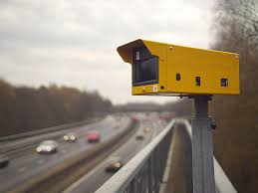
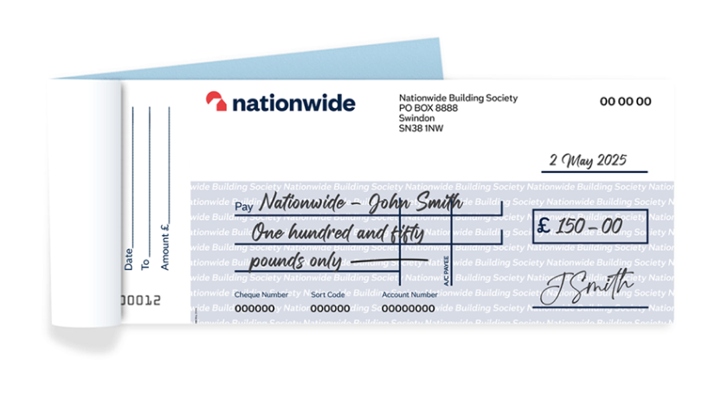
MANAGING DATA
Capturing Data: Data needs to be inputted into the database either manually or automatically.
Bank scans use Magnetic Ink Character Recognition for cheques.
Optical Mark Recognition is used for multiple choice questions on a test.
Other forms uses Optical Character Recognition
Selecting data: Selecting the correct data is an important part of data preprocessing – involves removing background information and data that doesn’t fit a certain criteria
An example could be a speed camera removing information other than the license plate and disregarding data from cars that didn’t speed.
Exchanging Data: The process of transferring the collected data is commonly done by an EDI (Electronic Data Interchange). It doesn’t require human interaction and enables data transfer between computers

Slide 60
NORMALISATION (DATABASES)
A table is in 1NF if no repeating attribute or groups of attributes are in the table.
Normalisation is a process used to produce the best possible design for a relational database. It ensures the tables are organised via:
. Removing unnecessary duplicated data
. Data being consistent throughout database
. The structure of the table is flexible enough to allow you to enter as many items as required
. Structure should enable a user to make complex queries relating data from different tables
ProductId | ProductName | Cost | Selling Price | CompId | Comp Name | Comp Qty | SupplierId | SupplierName
123 | Monkey | 2.5 | 5 | ST01 G56 | Stuffing Small eye | 30 2 | ABC BH Glass | ABC Ltd BH Ltd
156 | Cat | 3.1 | 6 | ST01 G120 | Stuffing Medium Eye | 30 5 | ABC XYZ Glass | ABC Ltd XYZ Ltd
In this example there are repeating groups – so this can be removed via two tables
Product
Component
However, this is M-M relationship, so a link attribute is difficult to create – so a link table is made
Product
ProductComp
Component
This can be now written as
Product(ProductID, Product Name, Cost, SellingPrice)
ProductComp(ProductID, CompID, CompQty)
Component(CompID, CompName, SupplierID, SupplierName.
For 2NF, a table must be in 1NF, and any partial dependencies are removed – where one or more attributes depends on only part of a composite key. This does not affect our table as the only composite key is in ProductComp and CompQty is affected both by ProductID and CompID

Slide 61


NORMALISATION CONTINUED
An example of making a database into 2NF and it affecting the table:
Event(EventID, Year, EventName, Winner, Time)
3NF is where the tables are in 2NF and contains no non-key dependencies.
All attributes are dependent on the key, the whole key and nothing but the key.
SupplierName is dependent on Supplier ID and not on the primary key, CompID.
It is therefore removed from this relation, and a new relation is created.
Importance of normalisation:
. No data redundancy, redundant data is data that appears in more than one database table – causes inefficiencies and inconsistencies
EventName is only dependent on Event ID not Year so this is a partial dependency
Event(EventID, Year, Winner, Time)
Name(EventID, EventName)
2NF Form
. Easier to maintain and change as data integrity is maintained.
. Faster sorting or searching as of having smaller tables.
. Saves storage space.
. Deleting records is easier and does not cause problems with other fields.
Product(ProductID, Product Name, Cost, SellingPrice)
ProductComp(ProductID, CompID, CompQty)
Component(CompID, CompName, SupplierID)
Supplier(SupplierID, SupplierName
FULLY NORMALISED

Slide 62


Structured Query Language is a declarative language used for querying and updating tables in a relational database.
SQL
CHAR(n) = Character string of fixed length n
VARCHAR(n) = Character string variable length, max n.
SELECT: Collects fields from a given table
FROM: Specify which table information comes from
WHERE: Specify search criteria
ORDER BY: Produces code in ascending order or descending order if Desc is added
ORDER BY DatePublished (Desc)
JOIN: Combining rows from multiple tables based on a common field between them
SELECT Song.SongTitle, Artist,ArtistName, Song.MusicType
FROM Song
JOIN Artist
ON Song.ArtistID = Artist.ArtistsID
WHERE Song.MusicType = “Latin”
CREATE: Creates new databases
ALTER: Used to add modify or delete fields.
DELETE: Delete a record
DELETE FROM tableName
WHERE column = value.
LIKE: Similar to, with % representing a wildcard
SongTitle LIKE S%
*: All
SELECT *
FROM table
INSERT INTO: Add a new record
UPDATE: Update a record in a table
UPDATE tableName
SET column1 = value1
WHERE column x = value.

Slide 63
REFERENTIAL INTEGRITY
Record locking is the process of preventing simultaneous access to records to prevent inconsistencies or a loss of updates.
However, a deadlock can occur.
Referential Integrity is the process of ensuring consistency – ensures that information is not removed if it is required elsewhere in a linked database
For transaction processing to occur, a database must have a set of properties to guarantee the transactions are processed reliably.
Redundancy is the process of having one or more copies of the data in physically different locations so if there is damage to one copy, there will remain an unaffected copy.
Atomicity requires that a transaction must be processed in its entirely or not at all.
Consistency ensure referential integrity rules will be specified between linked tables to maintain the integrity
Isolation property ensures that concurrent execution of transactions leads to the same result either way.
Durability property ensure that once a transaction has been committed, it will remain so even in the event of a power cut.

Slide 64
SLR11 NETWORKS
NETWORKS AND PROTOCOLS
NETWORK HARDWARE
TCP/IP STACK
NETWORK TOPOLOGY
DNS
NETWORK COMMUNICATION
NETWORK SECURITY

Slide 65


NETWORKS AND PROTOCOLS
A PROTOCOL is a set of rules defining common methods of data communication.
These rules need to be standard across all devices for them to communicate with each other.
WANs (Wide area networks) are networks that rely on third party carriers or connections and are spread over a large geographical area.
An example is the Internet
TCP (Transmission Control) IP (Internet Control) is used in the routing of packets through networks.
HTTP/S (Hypertext Transfer Protocol/Secure) is used for web page rendering.
POP3 (Post Office Protocol) and IMAP (Internet Message Access Protocol) are used for emails.
FTP (File Transfer Protocol) is used for transmission of files across networks.
LANs (Local area networks) are networks that consist of several computing devices on a single site or in a building, all connected by cables.
Users on the network can communicate with each other as well as sharing data and hardware devices.
They can transmit data very fast but only over short distances

Slide 66
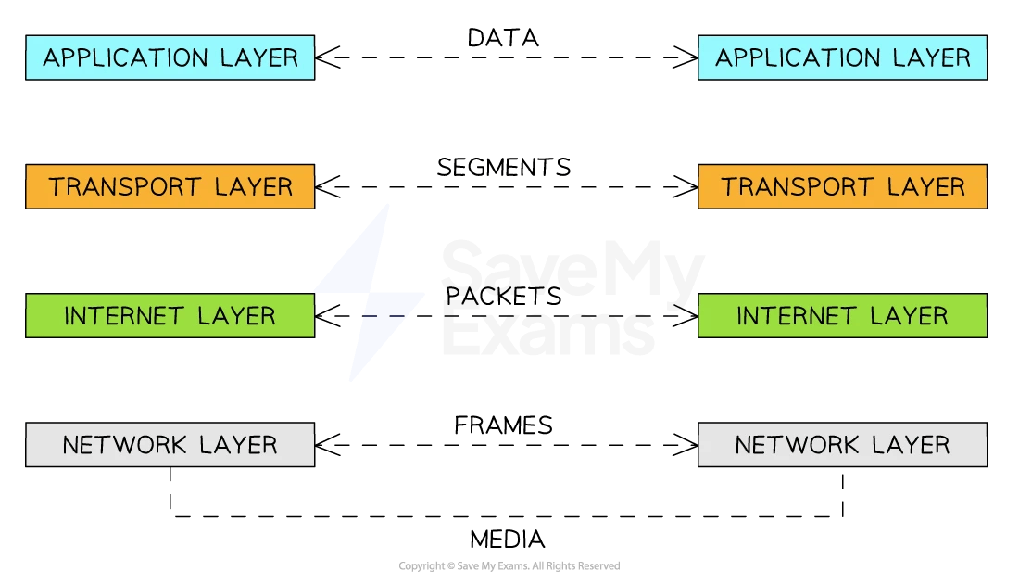
TCP/IP STACK
The Transmission Control Protocol/ Internet Protocol stack is a set of networking protocols that work together as four connected layers, passing incoming and outgoing data through all layers.
At each layer, the data is encapsulated in an envelope containing new packet data as it descends.
LINK: Physical connection between network devices and adds MAC addresses identifying the NICs of source and destination computers
So, once the packet has found the correct network using IP, It can find the device via MAC.
TRANSPORT: Uses TCP to establish an end-to-end connection with the recipient computer. The data is then split into packets and labelled (e.g. with port number and packet number)
If packets not delivered, transport layer requests retransmission of lost packets
INTERNET: Adds source and destination IP addresses
Port number + IP address = Socket address
Routers operate on network layer and will forward the packets on to the destination
APPLICATION: Uses protocols relating to applications being used to transmit data over a network e.g. FTP, IMAP

Slide 67
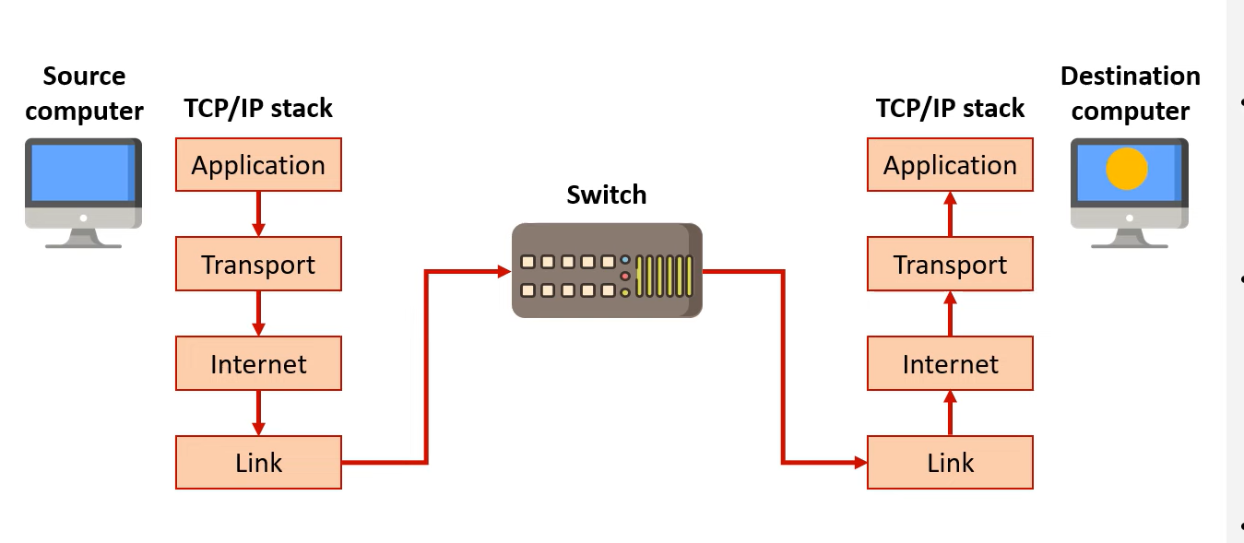
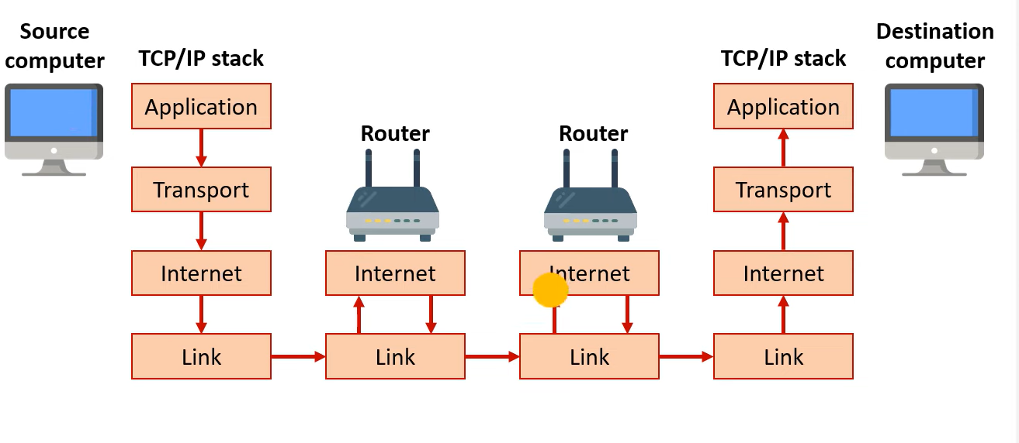
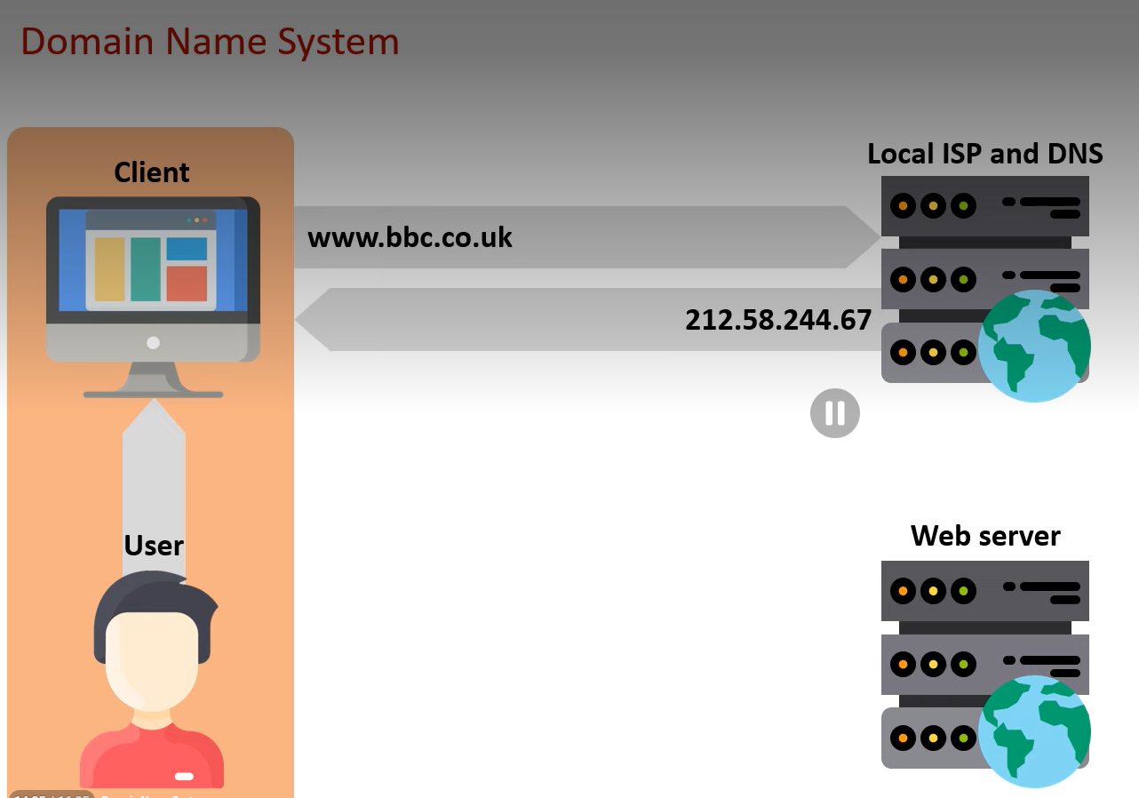
DNS
Network transmission over the same network does not require the DNS
URLS = Uniform Resource Locators and are the full addresses of an internet resource
DNS = Domain Name System with domain names identifying the area that an internet resource resides in.
IP Addresses = Internet Protocol addresses is a unique address assigned to a network device which routers use. IPv4: 32 bits, 4 decimals 0-256, separated by periods. IPv6, 32 hexadecimal digits, 8 groups, separated by colons
MAC Addresses = Media Access Control Addresses are the unique addresses assigned to a NIC so the physical device can be identified. 12 hexadecimal digits, separated by dashes/colons
Network transmission across multiple networks involves routers – the router reads the recipient’s IP address in each packet and forwards it on to the recipient via the fastest route.
DNS HOW IT WORKS: User requests URL via a browser
Browser sends domain name to DNS
DNS maps the domain name to an IP address and returns it to browser
Requested web page or resource is returned to the client’s web browser.

Slide 68
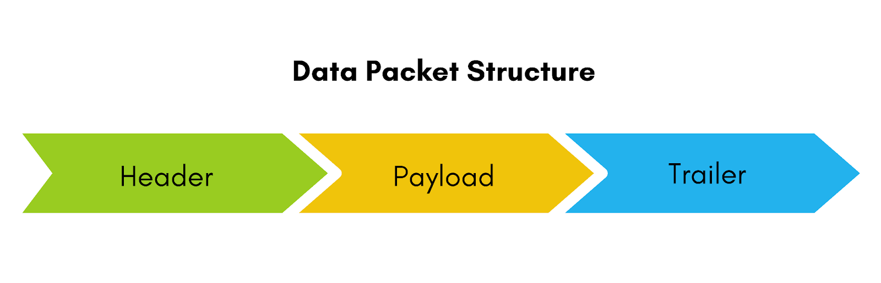
TWO TECHNIQUES TO EXCHANGE DATA OVER NETWORKS:
PACKET SWITCHING: Packets are sent various routes based on which route is most efficient.
NETWORK COMMUNICATION
PROS | CONS
Multiple methods to ensure data arrives intact (e.g. checksums) | Time is spent deconstructing and reconstructing packets
Multiple routes can be used, not reliant on one route | Must wait for all packets to arrive before data can be received
Packets can be transferred over very large networks
Data packets are segments of data that contain…
HEADER: Sender and recipient IP addresses
Protocol used
Order of packets
Time to live – tells the packet when to expire
PAYLOAD: Raw data to be transmitted
TRAILER: Checksum/cyclic redundancy check (detects error during transmission)
PROS | CONS
Data arrives in logical order, quicker reconstruction | Bandwidth is wasted during period in which no data is being sent
No delay e.g. for speech on a call | Devices must transfer and receive data at same rate
 | Using switches means electrical interference could be produced, corrupts/destroys data.
 | Sections of network cannot be used by other data until transmission has been completed
CIRCUIT SWITCHING: Direct link is created between two devices and is maintained for the entire conversation between devices. Requires both device to transfer and receive data at the same rate

Slide 69


Encryption keeps data secure by making it unreadable as talked about in SLR9
NETWORK SECURITY
Firewalls are a device to prevent unauthorised access to a network.
It consists of two NICs between the user and the Internet. The firewall passes packets between these two NICs and compares them against a set of rules set by the firewall software – packet filters
Packet filtering/static filtering limits network access in accordance with administrator policies. It does this by examining source IP, destination IP, protocols used and ports being requested.
Denied access to firewall then packets either dropped or rejected (sender is alerted to error)
Proxy servers act as an intermediary, collecting and sending data on behalf of a user.
PROS: Privacy
. Anonymity
. Caches frequently used website data making it faster to load
. Reduce overall web traffic
. Can be used by administrators to prevent access to sensitive info e.g. used in schools.
Potential threats:
Worms and viruses which can self replicate and spread. Viruses rely on host files to be opened to spread themselves whereas worms do not.
Trojans pretend to be useful files that when installed release their payload. They cannot self replicate.
Social engineering to gather passwords from vulnerable people

Slide 70
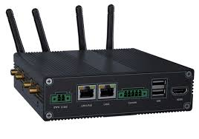
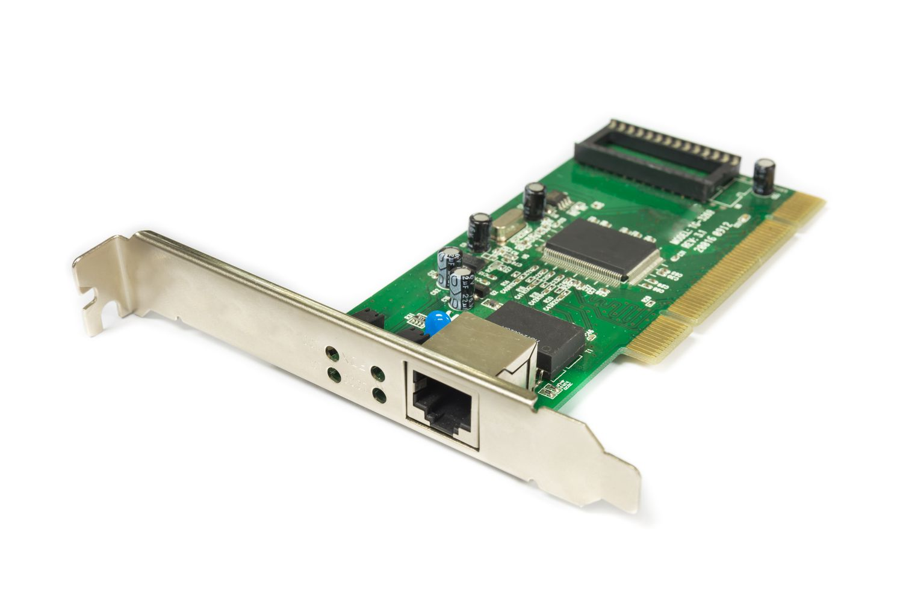
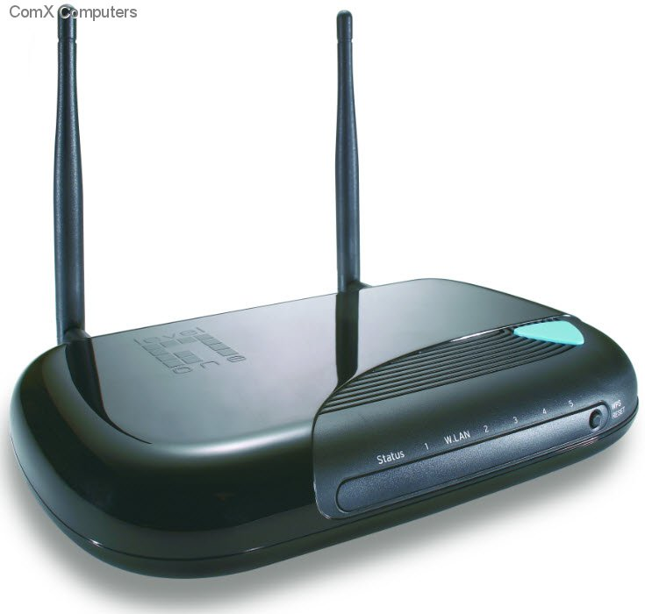


Used when protocols are different in networks as it translates protocols, networks can communicate, removes packets’ headers
NETWORK HARDWARE
Card required to connect a device to a network, assigns a MAC address
Allows a device to connect to a network usually in conjunction with the router. Used in mesh networks
Gateways
Network Interface Card (NIC)
Wireless Access Point (WAP)
NETWORK HARDWARE
Routers
Switch
Used to direct the flow of data across a network and are found in star topology.
Connects two networks together

Slide 71



NETWORK TOPOLOGY
Physical topology: Actual design layout
Logical topology: The shape of the path the data travels in and describes how components communicate across the physical topology
Physical Bus Topology: All computers are connected to a single cable with the cable ends being plugged into a terminator
Inexpensive and does not require additional hardware
But reliant on main cable, performance degrades with heavy traffic and low security.
Mesh Network Topology: Wireless topology where each node has a connection to every other node by transmitting across intermediary nodes, only one node needs a connection to the internet
No cabling costs, more nodes installed means the faster and more reliable the network becomes, new nodes automatically incorporated into the network, faster communication as packets do not need to travel via central switch
Physical Star Topology: A central node (like a switch or computer) acts as a router to transmit messages.
Not reliant on one cable, consistent performance, higher transmission speeds, no collisions as of separate cables, secure, easy to add new stations
But costly to install and reliant on the server.

Slide 72
SLR 12 WEB TECH
HTML
CLIENT SERVER AND PEER TO PEER
CSS
JAVASCRIPT
SEARCH ENGINE INDEXING
PAGE RANKING
SERVER AND CLIENT PROCESSING

Slide 73


Identifiers and class selectors are attributes given to elements on a web page which you wish to style in a particular way.
This can be defined within the head or within
a linked CSS style sheet. Classes are defined with
. and can be used multiple times. Identifiers are
defined with # and are used once
HTML
TAG | DEFINITON
<html> | All code between tags interpreted as HTML
<body> | Defines the main content
<head> | Defines the browser tab/ window heading area
<title> | Defines the text that appears with the tab/window heading area
<h1 | Headings with number referencing size
<p> | Paragraph
<img> | Images, used like < img src = location, height = x, width = y>
<a> | Anchor tag defining a hyperlink like <a href = “location”> LINK </a>
<ol> <ul> | Ordered and unordered list respectively
<div> | Divides the pages into separate areas
<li> | Defines an individual list item
HyperText Markup Language is what is web pages are written in.
It is made of tags written in angle brackets in opening and closing pairs:
E.G. <html> and </html>
Most web pages are separated into head and body. Head contains title and enrichment scripts whilst body contains main content like defining text, images and hyperlinks

Slide 74



Internal/embedded CSS is placed inside style tags and is entered directly into the HTML document.
CSS
CSS ( Cascading style sheets) is a scripting language like HTML and is normally used in conjunction with HTML. It is used to describe the layout and styles of a web page.
External CSS is written in a separate document and a link to this style sheet is added to the HTML document
Each section of CSS begins with the name of the class/identifier or element to be styled followed by a set of curly brackets where attributes are defined
This is how to define external CSS sheet which is added to HTML header

Slide 75


JAVASCRIPT
JavaScript is a language that uses the same programming constructs as other languages but is interpreted instead of compiled.
Unlike compiled code which is specific to a particular type of processor, JavaScript needs to be translated by the interpreter for whatever computer the browser is running on.
It adds interactivity to websites and is often used to validate input data on the client computer
JavaScript examples:
Advantages:
Local computer can deal with invalid data before it is sent off to the servers
Eases the load on busy servers
Reduced web traffic

Slide 76


SEARCH ENGINE INDEXING
Search engines rely on a database/index of web pages to find the pages you are looking for – to build this index, web crawlers/spiders are used which are software programs.
A search engine is a program that searches through a database of internet addresses looking for resources based on criteria set by the client
Web crawlers work by traversing the Internet, web page by web page using links on websites.
The web crawlers collect keywords and phrases from the linked web pages and add this info to the index.
They collect and also add meta tags, list of keywords the website owner adds to a webpage
As well, websites with more keywords in the <title> and <h1> tags, more relevant domain names and frequent updates are more likely to be at the top of the results list.

Slide 77

PAGE RANKING
This is an example of a search engine created by Google’s founders.
It sorts websites by the number of inbound links they receive, with a weighting to give importance to some inbound links (the page rank of linked websites dictates the weighting)
The PageRank of a page is constantly being recalculated and updated.
This can be displayed using a directed graph which shows which page is linked to other websites and webpages are represented as nodes.
PAGERANK algorithm is defined as:
PR(A) = (1-d) + d (PR(T1) / C (T1) + … + PR(Tn) /C (Tn))
PR(A) = Page rank of webpage
C(Tn) = Total count of outbound links from web page n
PR(Tn) /C (Tn) = The share of the vote that page A gets from page Tn. Each of these linked page's fractions are added together.
d = Damping factor set to prevent PR(Tn)/C(Tn) from having too much influence, notionally set to 0.85.

Slide 78

API (Application programming interface is a set of protocols that governs how two applications should interact with one another.
SERVER AND CLIENT PROCESSING
Client server model, data is processed by either client, server or both
Client-side processing is where data is processed on client computer – a local device. Uses languages like JavaScript
Webpage can immediately respond to user
Executes quickly
Gives developers more control over behaviour and look of website.
Server-side processing is where data is processed on the server. Uses languages like SQL
No plugins required
Can perform large calculations much faster than clients
Not browser dependent
More secure
If a server does lots of processing and storage, the thinner a client computer becomes.
Thin clients are
Easy to set up and maintain, allows data to be more secure as it is stored on one computer and software updates can be installed automatically from the server.
BUT
They are reliant on the server being active and powerful (expensive)
Thick clients are
Robust, reliable, operates without a continuous connections and is better for running powerful applications
BUT
Expensive, installation is time consuming due to being separately installed, integrity issues due to distributed data

Slide 79


Cloud computing refers to the service of providing access to software or files via the Internet using the client-server model e.g. OneDrive or Google Drive
CLIENT SERVER AND PEER TO PEER
CLIENT-SERVER network is where one or more clients/computers are connected to a powerful central server
It is secure as all files are stored centrally, backups are done centrally, and data can be shared within the network
But it is expensive to install and manage whilst requiring professional IT staff.
PEER-PEER network is beneficial for small LANs as individual computers are connected to each other.
It is cheap, not difficult to maintain and enables users to share resources e.g. printers.
But peer to peer networking is used for piracy due to the inability to trace the files which are being illegally downloaded.

Slide 80
SLR13 DATA TYPES
SIGN AND MAGNITUDE
TWO’S COMPLIMENT
FLOATING POINT BINARY
NORMALISATION
BITWISE MANIPULATION AND MASKS
CHARACTER SETS

Slide 81

SIGN AND MAGNITUDE
The most basic way to represent negative numbers with the equivalent of adding + or – sign in front of a number.
The convention is that a leading 1 is added for a negative number and a leading 0 is added for a positive number

Slide 82


TWO’S COMPLEMENT
One other method to represent negative numbers in binary, this has the advantage of making binary arithmetic with negative numbers much simpler.
This works by making the most significant bit negative (the bit on the left) for example 128 to -128.
This means with 1 byte we can represent numbers -128 to 127.
Converting to a negative two’s complement involves flipping all the bits and then
Keep all the digits up to the first 1 the same (LSB)
E.G 00000111 = 7 11111001 = -7
Subtracting with this representation is easy: Just make the number you are subtracting negative and add the two numbers together

Slide 83
FLOATING POINT BINARY
Decimals in floating point is represented by having the bits
after the floating-point decrease in powers of 2 e.g. 2^-1 = ½ 2^4 = 1/16
Floating point numbers can be thought of as scientific notation and can be split into two parts: mantissa and exponent
The mantissa is the number, and the exponent is how much it is shifted by. This is especially useful when calculating decimals.
Negative exponents: shift the decimal point left
Positive exponents: shift the decimal point right
As well, the first bit is always dedicated to the sign
with the original floating point after it.
If the Mantissa is negative, you must find the
twos compliment of it before hand and then
put the – sign after you’ve found the positive number.
01011010 0011: Mantissa: 0.1011010 Exponent: 0011
0.1011010 x 2^3 = 0101.101
4 + 1 + ½ +1/8 = 5.625
01000000 1110 Mantissa: 0.1000000 Exponent: 1110
0.1000000 x 2^-2 = 0.001
= 0.125
10101101 0101 Mantissa: 1.0101101 Exponent: 0101
0.1010011 x 2^5 = 010100.11
16 + 4 + ½ + ¼ = 20.75 but the sign was negative so its -20.75

Slide 84
NORMALISATION
Floating point numbers are normalised to make sure that they are as precise as possible in a given number of bits. – basically, making the most use of the mantissa as possible.
0.0001011 0101
0.1011000 shift of 3 places to the right
Subtract 3 from exponent so exponent becomes 0010
Normalised number is 01011000 0010
Adjust the mantissa so that it starts with 01 for a positive number or 10 for a negative number. Fill empty spaces with 0s
Because the mantissa is bigger/smaller from the shifts, the opposite must be applied to the exponent, so the same number is represented.
Addition and subtraction:
LINE UP THE POINTS BY MAKING THE EXPOENENTS EQUAL
ADD OR SUBTRACT THE MANTISSAS
NORMALISE THE RESULT.
11110111 0001
1.0111000 Shift of 3 places to the right
Subtract 3 from exponent so exponent becomes 1110
10111000 1110
Converting a denary number to normalised floating point binary:
-14.25
14.25 = 01110.010
-14.25 = 10001.110
Shift 4 places left 1.001110 0100

Slide 85



BITWISE MANIPULATION AND MASKS
Shifts preformed on binary numbers are called logical shifts. Shifting left is a multiplication of 2 to the power of the number of shifts.
Shifting right is a multiplication of ½ to the power of the number of shifts.
Meanwhile masks can be applied to binary numbers by combining them with logic gates.

Slide 86


CHARACTER SETS
A character set is a published collection of codes and corresponding characters which can be used by computer for representing text.
ASCII (American Standard Code for Information Interchange) was the leading character set before Unicode. It utilised 7 bits to produce 128 characters however this is a very limited amount especially when considering other languages.
But Unicode was soon created with 16 bits and then 32 bits so over a million characters can be represented making it ideal to be a unified format for all languages and was introduced all over the world. However, it did increase file size and data transmission times due to each character being represented by 4/8 bytes compared to 2.

Slide 87
SLR 14 DATA STRUCTURES
BASIC DATA STRUCTURES
STACKS AND QUEUES
LINKED LISTS
GRAPHS
TREES
HASH TABLE

Slide 88








BASIC DATA STRUCTURES
A file/database consists of several records; Records consist of fields.
An array is an ordered, finite set of elements of a single type. Arrays are always taken as zero-indexed
Below is a linear array (1d), however multi-dimensional arrays also occur.
Record
File/ database
Field
A tuple is an ordered set of values, which could be any type unlike arrays.
A tuple is immutable which means that its elements cannot be changed and you cannot dynamically add elements to or delete elements from a tuple
A list is a data structure consisting of ordered elements where items can occur more than once. Its size is unfixed so we can refer to the last item and first item in the list.

Slide 89


STACKS AND QUEUES
A queue is a first in, first out data structure and can be either static
or dynamic. New elements may only be added to the end of a queue,
and elements may only be retrieved from the front of a queue.
Sequence is determined by the order of insertion.
Queues make use of two pointers, one pointing to the front of the queue and one at the back
Uses: Printing output, characters typed at a keyboard, simulations modelling real life situations like checkouts, traffic lights.
A stack is a last in, first out data structure.
A stack may be implemented as either a static or dynamic structure.
Static: Two pointers, top of the stack, holding the size of the stack.
Dynamic: One pointer at top of the stack.
Circular queues are when the back pointer points to the front of the queue if the front element is empty when the back of the queue is full.
A stack overflow can occur if an item is pushed into a full stack and an underflow error can occur if an empty stack is popped

Slide 90



LINKED LISTS
To insert in an ordered list, the pointer field of the node before must be changed to the new node with the new node pointing to the next node.
A linked list is a dynamic data structure used to hold an ordered sequence.
The items which form the sequences do not have to be stored in contiguous data locations
Nodes make up linked lists and have a data field (holds the data) and a pointer field (holds the address of the next item in the sequence.)
Last item in linked list has a null pointer to indicate the end.
Head Pointer variable associated with the list contains the address of the first node in the list.
To insert a node, in an unordered list at the start you create the node and have its pointer field point to the node at the head pointer and the head pointer to point to new node.
To delete a node, you need to find it and the value of its pointer field. Change the pointer field value of the previous node to the value noted.
Free the memory location of deleted node.

Slide 91




LINKED LISTS CONTINUED
Initialisation using record:
Deletion of node
Traversal using record
Insertion of node into an unordered list.
Benefits of linked lists:
Dynamic size so the list can grow or shrink as needed
Easy insertion and deletion as only requires pointer updates
No wasted memory from unused array slots.
Cons:
- Requires extra memory for storing pointers
- No direct access, sequential access only
- More complex to implement than arrays.

Slide 92


GRAPHS
Depth first – Go as far down one route before backtracking and taking the next route.
Traversal of a graph: Breadth first – where we visit all neighbours of the starting node and then all the neighbours of the second node and so on.
A graph is a set of vertices/nodes connected by edges/arcs.
These edges can be one way or two way but in an undirected graph they are all bidirectional, and in a directed graph they are directional.
Edges can be weighted to show there is a cost to travel between nodes e.g. distance.
Graphs can be used to represent computer networks, roads, web pages and links, tasks in a project etc.
Graphs can be implemented by either an adjacency matrix (2d array) or adjacency list
Matrix: Each node is represented by a row and collum with the “weight” between two nodes being the value stored in the cell.
They are very convenient due to quick access times and it’s easy to add nodes.
List: List of dictionaries with all the nodes being the key. Each node has a list of all nodes and weights it is linked to. This is very space efficient and is better for larger, sparse networks.

Slide 93
TREES
TREE DESCRIPTION
TREE TRAVERSAL

Slide 94

Root
TREE DESCRIPTION
Trees are data structures. A rooted tree has a root which is the node with no incoming edges.
Like graphs, there are nodes and edges but differently there are parents, children and leaf nodes with a leaf node meaning the node has no children.
Trees are used for manipulating hierarchal data (such as folder structures), making information easy to search or manipulating sorted lists of data.
A binary tree is a rooted tree with each node having a max of two children – this allows binary trees to be searched easily and quickly
Leaves
A binary tree can be implemented using an array of records with each node consisting of left pointer, data item, right pointer.
 | Left | Data | Right
Tree[0] | 1 | 18 | 4
Tree[1] | 2 | 12 | 3
Tree[2] | -1 | 5 | -1
Tree[3] | -1 | 14 | -1
Tree[4] | -1 | 22 | -1
18
12
22
5
14

Slide 95










TREE TRAVERSAL
IN-ORDER, as you pass underneath the node, output data
PRE-ORDER, as you pass the left of the node, output data
POST-ORDER, as you pass the right of the node, output data

Slide 96

HASH TABLE
Hash tables are primarily used for efficient lookup and encryption.
They are also used in the implementation of dictionaries.
A hashing algorithm/function can be used to create an index by taking in data (key) to produce a unique output (hash). The hash function maps the key to a unique index in the hash table.
Collisions can occur when two keys produce the same hashed value, rehashing can be done to resolve collisions.
It involves assigning the collided data to the next empty slot in the hash table.
A good hashing algorithm should have a low rate of collisions
A hash function can be created for strings by using the ASCII code for each character. E.G. using the hashing algorithm MOD 11, CAB = 67 + 65 + 66 = 198
198 Mod 11 = 0 = hash value so CAB is stored in location 0 in the hash table if it is empty
To search for an item:
Apply hashing algorithm to the key field of the item
Examine the resulting cells,
. If item is there, return item.
. If empty, item is not in table.
. If there is another item in that spot, move down the hash table until item is found or empty cell.

Slide 97
SLR15 BOOLEAN ALGEBRA
LOGIC GATES
KARNAUGH MAPS
SIMPLIFYING BOOLEAN ALGEBRA
LOGIC CIRCUITS

Slide 98


LOGIC GATES
A truth table shows every possible permutation of inputs to a logic gate and the corresponding output.
Boolean equations are made by combining Boolean operators.
Sometimes a really long Boolean expression is identical to another more desirable, shorter expression
There is not too much to know to be honest

Slide 99



KARNAUGH MAPS
A Karnaugh map can be used to simplify Boolean expressions
Corresponding Karnaugh Map
Highlight the 1s on the Karnaugh Map using the fewest rectangles.
Rectangles can overlap and loop around the table.
Now we have two rectangles.
1 rectangle represents (¬C ^ ¬B) (A V ¬C)
The other vertical rectangle represents (A ^ ¬B), we join these statements with OR logic gates now
Corresponding truth table
Make sure when dealing with more than 2 variables, the fields corresponding to 2+ composite variables are arranged in a form where the subsequent term reflects a change in only 1 variable 00 -> 01 -> 11 -> 10

Slide 100
Commutative rule:
Order of literals around an operator does not matter e.g. Y V X = X V Y
SIMPLIFYING BOOLEAN ALGEBRA
BASIC RULES:
X ^ 0 = 0
X ^ 1 = X
X ^ X = X
X^ ¬X = 0
X V 0 = X
X V 1 = 1
X V X = X
X V ¬X = 1
Absorption rules:
Removing unnecessary expressions.
(X ^ ( X V Y) = X
X V (X ^ Y) = X
DE MORGAN’S LAWS:
This involves converting Boolean function into a function only using NAND or NOR functions. Most used when a negation applies to the whole of an operator
¬(A V B) = ¬A ^ ¬B
¬(A ^ B) = ¬ A V ¬ B
Conjunction is replaced by disjunction and vice versa
Double negation:
If negation happens twice, both negation can be removed. E.g. X = ¬¬X
Distribution.
(A ^ B) ^ ( A^ C) = A ^ ( B ^ C)
(A V B) V ( A V C) = A V (B V C)
Association:
Addition or removal of brackets and reordering literals.
(A ^ B) ^ C) = A ^ B ^ C

Slide 101






LOGIC CIRCUITS
A half adder can take an input of two bits and give a two-bit output as the correct result of an addition.
A flip flop is an elemental sequential logic circuit that can store one bit and flip between two states.
It has a control signal input and a clock input.
A full adder can take three inputs with 1 being a carry bit.
You can concatenate full adders to make adders that take more than one bit.
Clock diagram: the output of a D type flip flop can only change at a rising edge as it is a positive edge triggered flip flop
A D-type flip flop uses 4 NAND gates and updates value of Q to the value of D when the clock ticks. Q is a stored value – 1 bit memory.
Register memories and static RAM are constructed by connecting these flip flops in a row,
Negation of Q

Slide 102
SLR16 COMPUTER RELATED LEGISLATION
DEFINITION AND EXAMPLES
DATA PROTECTION ACT 1998
COPYRIGHT DESIGNS AND PARENTS ACT 1988

Slide 103

DEFINITION AND EXAMPLES
Legislation related to privacy can be broadly categorised into laws intended to protect personal privacy and those which have been passed in interests of safety, crime detection, or counter-terrorism.
Regulation Of Investigatory Power Act 2000:
The RIPA covers investigation, surveillance and interception of communication by public bodies e.g. CIA wire-trap online conversations provided a warrant has been issued
It enables:
Certain public bodies to demand that an ISP provides access to a customer’s communication in secret
ISPs must have hardware to facilitate surveillance
Mass surveillance of communications
Public bodies can monitor people’s internet activities
Computer Misuse Act 1990:
Designed to prevent unauthorised access to programs or data and malicious use of computers e.g. hacking.
Offences include:
Unauthorised access to computer material
Unauthorised access with intent to commit a crime
Unauthorised modification of computer material

Slide 104

All data users must register with the Data Commissioner
DATA PROTECTION ACT 1998
THE 8 PRINCIPLES:
Data must be processed fairly and lawfully
Data must be adequate, relevant and not excessive
Data must not be retained for longer than necessary
Data can only be used for the purpose for which it was collected
Data must be accurate and
up to date
Data must be kept secure
Data must be handled in accordance with people’s rights.
Data must not be transferred outside the EU without adequate protection.
Data protection act 2018 is data protection act 1998 + GDPR (General Data Protection Act)
DPA controls how your personal information is used by companies and the UK government.
It says that anyone who stores personal details must keep them secure and computer systems must have sufficient security
An individual who can be identified by personal data is referred to as the data subject.
The act gives data subjects certain rights like the right to request a copy of data held about them and the right to prevent marketing.

Slide 105


COPYRIGHT DESIGNS AND PARENTS ACT 1988
The act is designed to protect the creators of books, music, video, and software from having their work stolen/illegally copied. However, not everything can be copyrighted e.g. algorithms are not eligible for copyright so new sorting algorithms for example can be used by anyone without permission.
If an individual believes that their work has been copied, it is their responsibility to take action under the act.
It does this by making it illegal to use, copy or distribute commercially available software without an appropriate license or permission
Copyright applies automatically if a work is original and does not expire until 25-70 years after the death of the creator depending on the type of work.
E.g. Steamboat Willie is now back in the public domain

Slide 106
SLR17 MORAL, SOCIAL, ETHICAL ISSUES
ECONOMIC IMPACT
ARTIFICIAL INTELLIGENCE
ENVIRONMENTAL EFFECTS
PRIVACY AND TROLLS
LAYOUTS

Slide 107

ECONOMIC IMPACT
Ethics are concerned with our values as a community and how these will impact different groups of people in society.
Morals are to do with our personal code of conduct; encompasses behaviour and decisions we make.
Computers in the workplace:
Benefits:
Improve efficiency via reduced delivery time (e.g. Amazon using drones) and increased manufacturing speed.
Reduce strain on works as reduced need to work in a repetitive and tedious environment.
Increased demand for people in computer-related occupations.
Online shopping allows businesses to cut rent and labour costs.
Disadvantages:
Loses jobs for people creating high levels of structural unemployment. Yet the effects of this could be reversed due to high consumer demand for cheaper services will create employment in other sectors. As well, the government can offer retraining programmes so people can change occupations.
Causes a shift towards low-income service jobs.
There is the argument that computers have created a 1% economy in which the top Internet Companies (YouTube, Instagram, Snapchat) have accumulated mass wealth at the expense of lots of workers.
As well, user-generated content can damage the music, video and publishing economy from the monopoly YouTube has.

Slide 108


ARTIFICIAL INTELLIGENCE
Problems arrive with AI generated content replacing artists and causing higher unemployment.
As well, AI is used in voice recognition systems which are convenient does raise questions about privacy due to needing to be switched on all the time to function
Accountability is hard to determine with AI and at what stage is it considered sentient and if so, what rights should it have.
Artificial intelligence is the ability of a computer to replicate human intelligence, cognitive ability, and grasp abstract concepts.
It is used in expert systems to draw connections between illnesses to form diagnoses.
Neural networks can be created which can be used to replicate biological neural networks and is used in pattern detection and picking up on financial fraud.
Automated decision making can be based on AI or not. They have many effects:
Social media feeds, however, could create a close-minded society due to only showing content based on users’ interactions and inferences about interests.
Used in various application processes which means people could be treated unfairly especially if there is no consideration for contextual factors. However, has made hiring more convenient.
Used heavily in trading in the stock market and to model future changes.
Used in self driving cars but raises the problem of accountability and the decisions an algorithm makes when there is unavoidable harm.
These algorithms need thorough testing to produce software free of bias.

Slide 109


ENVIRONMENTAL EFFECTS
Environmental issues include the carbon footprint and waste products that result from manufacturing computer systems.
However, renewable energy can counteract the use of non-renewables.
Environmentally friendly technologies are growing as well e.g. smart home systems that can use sensors to change temperatures accordingly.
Working at home can mean less need for big offices meaning less heating and lighting needed. Less car emissions as less people need to drive to work.
Computer managed engines can work more efficiently, using less petrol and creating less pollution.
As computer systems become cheaper, more are bought and produced. The pressure of keeping up with trends means that people now throw away devices more than ever – throw away society.
Computer components can be built from toxic materials such as mercury or radioactive isotopes; these can contaminate water supplies.
E-waste is shipped to third world countries with lower environmental standards to be disposed – immoral and unacceptable.
More electricity is required to power computers requires more use of non-renewable fossil fuels which emit greenhouse gases – climate change, biodiversity reduced, future generations impacted.

Slide 110

PRIVACY AND TROLLS
Monitoring is used consistently for crime prevention and detection however they can also be used to monitor employee behaviour or your own behaviour (smart watches.)
Trolls, cyberbullying, cyber stalking and misogyny are common occurrences on the Internet mainly due to the anonymous front it provides.
The Malicious Communications Act 1998 makes it a criminal offence to send indecent or offensive messages to anyone online.
Analysis of personal info is key for companies to reveal insights about people + behaviours. Large amounts of data can be gathered via data mining so it can be used for targeted advertising or to inform personalised political propaganda for example
Data mining can have the negative effect on people such as an insurance people finding out if someone is high risk of developing a disease so they can charge more.
Although it is legally required to state what data companies are collecting from you (Data Protection Act 2018), it may not be always transparent.
Censorship is the act of suppressing content that people can view, publish and access. Some countries use it to block out political opinions or extremist beliefs.
The problem is when censorship is no longer for protection but to push an ideology.
Within schools and workplace, censorship may be used to maintain high productivity and prevent distractions

Slide 111

Colour Paradigms:
Different colours are interpreted differently around the world with negative connotations being associated with colours across the world.
The safest colour is blue although it can still represent sadness.
LAYOUTS
Websites designed in one country are viewable all over the world, so if they are intended for international viewership there needs to be consideration for layout, colour and character sets.
Layouts: Websites must be laid out so it is easy to navigate between pages.
Examples of how to make a website more accessible via a layout:
Arabic countries read from right to left
Needs the option to enlarge text for visually impaired people or alter the contrast.
Transcripts of audio files should be provided for hearing impaired people.
Character Sets:
Contents of website must be translated into multiple languages. For this, Unicode is preferred as ASCII with 7 bits cannot contain all possible characters such as the Chinese language.
These design considerations make website more accessible to all people, attract more customers

Slide 112
THINKING ABSTRACTLY

Slide 113
THINKING AHEAD

Slide 114
THINKING PRODCEDURALLY

Slide 115
THINKING LOGICALLY

Slide 116
THINKING CONCURRENTLY

Slide 117
SLR23 PROGRAMMING TECHNIQUES
MODULARITY
VARIABLES AND PARAMETERS
RECURSION
IDE

Slide 118

MODULARITY
Modular programming is a technique used to split large complex programs into smaller, self-contained modules
Benefits include:
. Reusability of components once a module is tested
. Big projects can be divided between a team
. Simplifies testing and maintenance.
. Easier to understand and approach small modules than the whole problems.
. Different team members with different specialties can handle different modules suited to them specifically.
A technique to modularise programs is called the top-down approach, in which the problem is continually broken down into sub-problems until each can be represented as an individual, self-contained subroutine that performs a certain task. This process can also be called stepwise refinement.
Modules may be referred to as subroutines, procedures (returns no value), functions (returns a value) or methods.
The first line of a subroutine specifies the interface for that subroutine for example e.g. procedure subroutine1(parameter1)

Slide 119
VARIABLES AND PARAMETERS
Global variables, on the other hand, can be accessed across the whole program and is the automatic state variables are declared to be and are useful for values than need to be used by multiple parts of the program.
Variables can be defined with either global or local scope. Scope refers to the sections of code in which the variable is available.
Local variables have limited scope so can only be accessed within the block of code in which they were defined. Using local variables is good programming practice as in ensures subroutines are self-contained, with no danger of variables being affected outside of the subroutine.
However, they require more memory as they are not terminated until the program is terminated unlike local variables which are deleted at the end of the subroutine. Also, global variables can be unintentionally overwritten.
BY VALUE:
Treated as a local variable; a copy of the value is passed to the subroutine and discarded at the end.
BY REFERENCE:
The address of the parameter is given to the subroutine, so the value of the parameter will be updated at the given address
Functions typically use local variables however procedures typically use parameters.
When parameters are passed into a subroutine, they can be passed either by value or by reference.
In tests, assume parameters are passed by value unless told otherwise: Format = function multiply(x:byVal, y:byRef)

Slide 120



RECURSION
Recursive subroutines are a programming construct in which a subroutine calls itself during execution and it has these 3 characteristics:
Contains a stopping condition
For any input value other than the stopping condition, the subroutine should call itself
The stopping condition should be reachable within a finite number of times.
Stopping Condition
Advantages: Problems can be represented in fewer lines of code, which makes them less prone to errors
Disadvantages: Inefficient use of memory as all previous variables must be remembered in the stack, danger of a stack overflow when the call stack runs out of memory and is difficult to trace
Each time a function calls itself, a new stack frame is created within the call stack, where parameters, local variables and return addresses are stored. This information allows the subroutine to return to that point during its execution.
When the stopping condition is reached, the subroutine unwinds and information on the call stack is popped off.

Slide 121

IDE
An Integrated Development Environment is a program which provides a set of tools to make it easier for programmers to write, develop and debug code and a comprehensive and integrated platform that compiles code as well.
Visual Studio’s IDE
FEATURE | EXPLANATION
Stepping | Monitor the effect of each individual line of code by executing a single line at a time.
Variable Watch | Allows developers to monitor value of variables as the program executes and can be used to diagnose logical errors and debug.
Source Code Editor | Autocompletion of words, indentation, syntax highlighting and automatic bracket completion makes code clearer to write and read.
Breakpoint | IDEs allow users to set points in the program at which the program will stop, and this can help with debugging as it can help to pinpoint where an error is occurring
Debugging Tools | Run time detection errors can be shown to the developer with highlighted line numbers where the problem occurred to assist with debugging.

Slide 122
SLR24 COMPUTATION METHODS
COMPUTABLE PROBLEMS
RECOGNITION, ABSTRACTION AND DECOMPOSITION
DIVIDE AND CONQUER
PROBLEM SOLVING STRATEGIES

Slide 123

COMPUTABLE PROBLEMS
A problem is considered computable if an algorithm can solve it.
Hardware and exponential complexity can pose limits on algorithms making a problem not computable even if it is technically solvable for example a problem requiring more memory than feasible – instead, heuristic methods are normally used to get an approximate solution.
Features that make a problem solvable:
Abstraction and Decomposition: The problem can be broken down and made simpler by removing unnecessary details.
Enumeration: Exhaustive search, an algorithm that attempts all possible solutions. For example, a problem like a 4-digit password can be solved through brute force.
Simulation: The problem can be solved if I can be modelled in a computer.
Theoretical Approach: If a problem can be boiled down to pure theory, it can be represented using maths equations.

Slide 124
RECOGNITION, ABSTRACTION AND DECOMPOSITION

Slide 125
DIVIDE AND CONQUER

Slide 126


PROBLEM SOLVING STRATEGIES
Apart from previously stated strategies there are a few more:
BACKTRACKING: Involves using algorithms often recursively to methodically visiting each path and building a solution based on the paths found to be correct. If a path is invalid, it backtracks to the previous stage and visits an alternate path. E.g. Depth-first graph traversals.
HEURISTICS: Find an approximate solution to a problem when the standard solution is unreasonably time-consuming or resource-intensive to find. It is not perfectly accurate or complete. It is often used in machine learning and language recognition.
PERFORMANCE MODELLING: Mathematical methods are used to test a variety loads on different operating systems. This is cheaper, less time consuming and safer than true performance testing and is used in safety-critical computer systems which cannot do trial-runs like aeroplanes. The results can help judge capabilities of a system, how it copes in different environment and assess whether it is safe to implement.
VISUALISATION: Data can be presented in a way that is easier to understand particularly statistical data through graphs, trees, charts and tables.
DATA MINING:
Used to identify patterns or outliers in large sets of data termed big data. Data mining is used to spot trends, identify correlations and then this data can be used to make future predictions. This is useful in marketing and business decisions however the handling of personal data must be dealt within accordance to present legislation.

Slide 127
SLR25 ALGORITHMS
SEARCHES
BUBBLE AND INSERTION

Slide 128


SEARCHES
Linear search is when the list is searched sequentially until the desired item is found.
List does not need to be sorted and is easy to implement.
Very inefficient
Binary search algorithm can only be applied on sorted data and works by finding the middle element in a list of data.
The unwanted half of the data is then discarded and the process repeated until the desired element is found or the element cannot be found.
Faster than linear search on larger datasets.

Slide 129


BUBBLE AND INSERTION
Insertion sort sorts one data item at a time. The algorithm takes one data item from the list and places it in the correct position in the sorted list.
More efficient than bubble, less efficient than merge and quick.
Bubble sort is when you go through a list and comparing each item with the next item, if it is greater swap. After each pass the last element of the array will be in the correct place.
Repeat either n-2 times with n being reduced by 1 each pass, or until no swaps have been made in one pass.

Slide 130
SLR26 ALGORITHMS 2
MERGE SORT
QUICK SORT
DJIKSTRAS PATHFINDING
A STAR PATHFINDING
BIG O NOTATION

Slide 131

MERGE SORT
Fastest of all sorts, hardest to implement
Merge sort uses a divide and conquer approach. The list is successively divided in half – forms two sub lists. This repeats until the length of one sub list is 1.
Repeatedly merge sub lists to produce new sorted lists until only one sub list remains
Implementation does not need to be known for test

Slide 132

QUICK SORT
Speed is dependent on the pivot – generally fast
It does not need additional memory.
If split points are not near the middle, division will be very uneven – inefficient.
If the list is very large and recursion continues too long, stack overflow errors could occur and program will crash.
Quick sort works by selecting an element (pivot) , often the central element, and dividing the input around it.
Elements smaller than the pivot are placed in a list to the left of the pivot, others are placed in a list to the right.
This process repeats recursively on each smaller list until each list has a length of 1 or each element used to be a pivot.

Slide 133


DJIKSTRAS PATHFINDING
We need computers to find the shortest path between two points – optimisation problem
E.G: Circuit boards, route planning, communication networks
Dijkstra's algorithm:
The algorithm is commonly implemented using a priority queue on a weighted graph
Starting from the root node (A) add all distances to all the immediately neighbouring nodes to the priority queue. All remaining nodes have a distance of infinity.
Remove the first node from the front of the queue – this distance is the shortest distance between root and neighbouring node as priority queue is automatically ordered by size.
Traverse all of the nodes connected to removed node without going over paths already taken.
If total distance passing through the removed node to the neighbouring node is smaller than the distance currently stored with this node, update this value with the smaller value. A to C to B is 5, A to B is 7.
If all paths of the node have already been recorded, ignore it
6. Continue steps 2 to 4 until goal node is reached then trace through the table to find the shortest distance which is ADE with a value of 11

Slide 134




A STAR PATHFINDING
A* algorithm has two cost functions:
Real cost from the source to a given node
Approximate cost from the node to the goal node – heuristic function
For the algorithm to work, the heuristic function should never overestimate the real cost.
Whilst the Dijkstra's algorithm finds the shortest distance to each node, A* only finds the shortest distance to the goal node.
A* algorithm efficiency is dependent on the accuracy of the heuristics.
Blacked out vertexes have been visited; we ignore B as we know it will have a longer path from the heuristic
We have now visited all adjacent nodes to E, so we know A C E is the shortest distance

Slide 135


As well, space complexity is the amount of resources an algorithm requires.
BIG O NOTATION
The time complexity of an algorithm is how much time it requires to solve a particular problem – represented by Big-O notation.
It shows the upper limit of time it would take to solve relative to number of data elements.
To reduce time complexities, reduce loops and number of operations
Worst case time complexities
Linear search notation – O(n)
Binary search notation – O(logn)
Bubble sort notation – O(n^2)
Insertion sort notation – O(n^2)
Merge sort notation – O(nlogn)
Quick sort notation – O(n^2)
Hashing table notation – O(n)
O(1) - Constant, same amount of execution time for any size of input.
O(logn) - Logarithmic. Impact of an algorithm is directly proportional to the logarithmic result of the input size.
O(n) - Linear, algorithms execution is directly proportional to the input size.
O(n^2) - Polynomial, Directly proportional to the square of the input size.
O(2^n) - Exponential, The time it takes will
double with each additional item in the input.

Slide 136
MOCK NOTES:
NEED TO KNOW MORE ABOUT ENCRYPTION
LINKED LISTS
LONGER QUESTIONS IN GENERAL

